Slide 1




Unfolding the Atmospheric Muon Flux with IceCube Pascal Gutjahr
wiki page
CR Call
October 28, 2025
Source: NASA

Slide 2

Determine Regularization

Slide 3
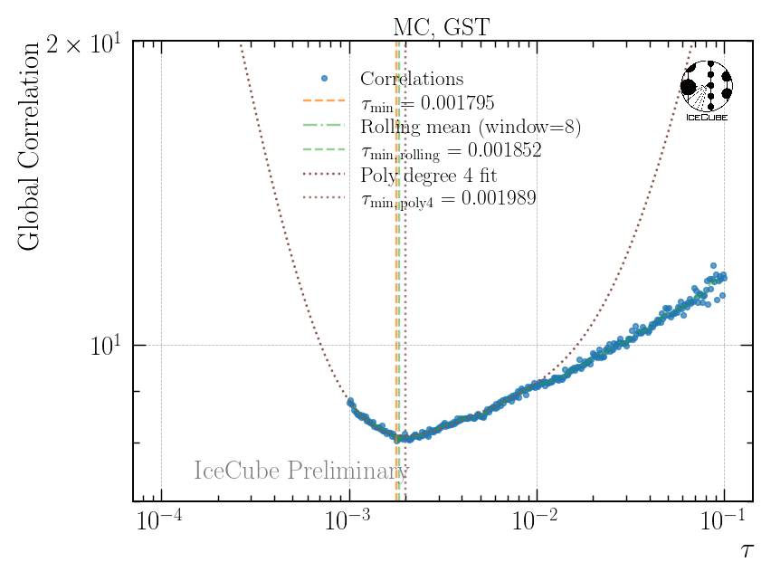
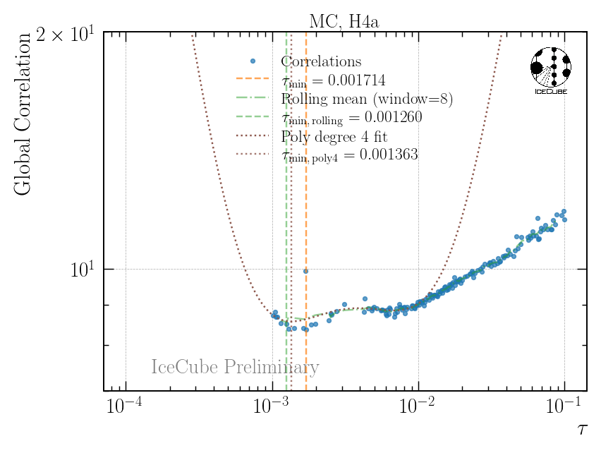
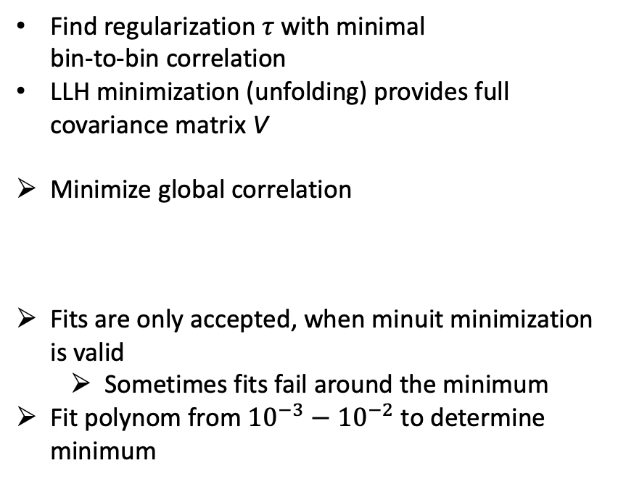
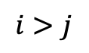
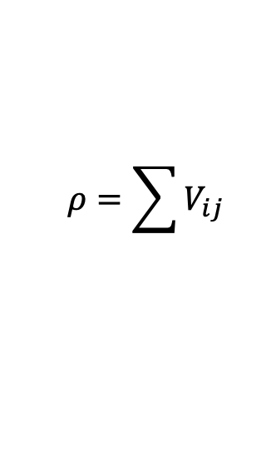
Regularization
Find regularization 𝜏 with minimal bin-to-bin correlation
LLH minimization (unfolding) provides full covariance matrix V
Minimize global correlation
Fits are only accepted, when minuit minimization is valid
Sometimes fits fail around the minimum
Fit polynom from ${10}^{−3}−{10}^{−2}$ to determine minimum
$$ρ=\sum{V_{ij}}$$
$$i>j$$
2 examples

Slide 4
“Method Bias”

Slide 5
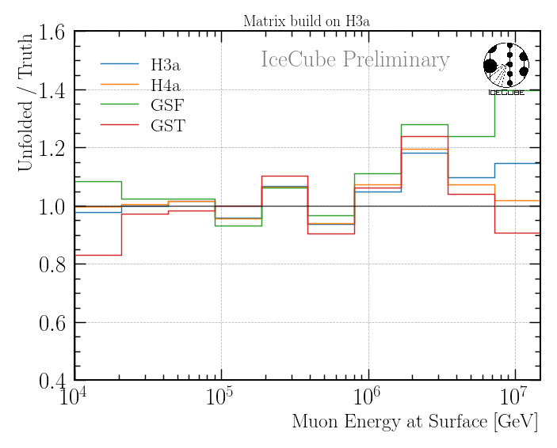
Uncertainties: “Unfolding Bias” (for H3a Matrix)
Build unfolding matrix on H3a
Unfold 4 MC weighted datasets for the 4 primary models
Divide each unfolding by its true MC distribution
Ratio of 1 expected
Offset to 1 → bias

Slide 6
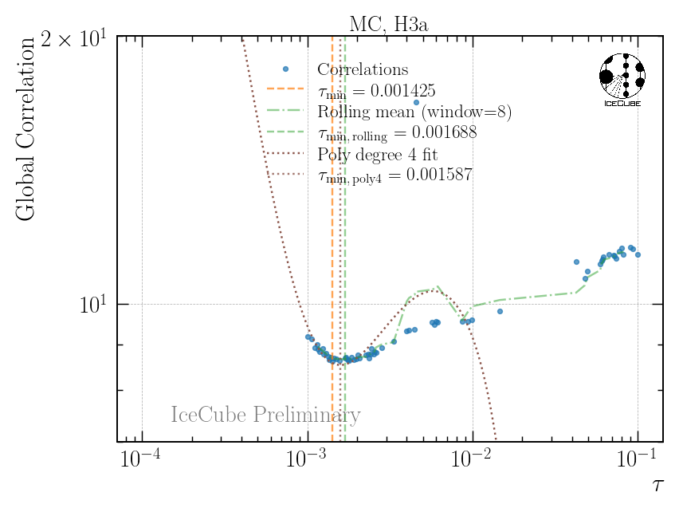

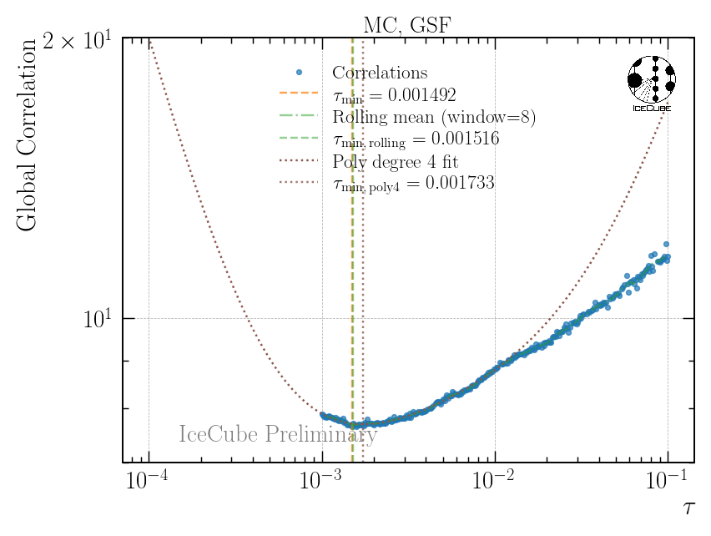
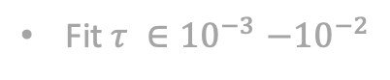
H3a Unfolding Bias
Fit $τ {∈10}^{−3}−{10}^{−2}$

Slide 7
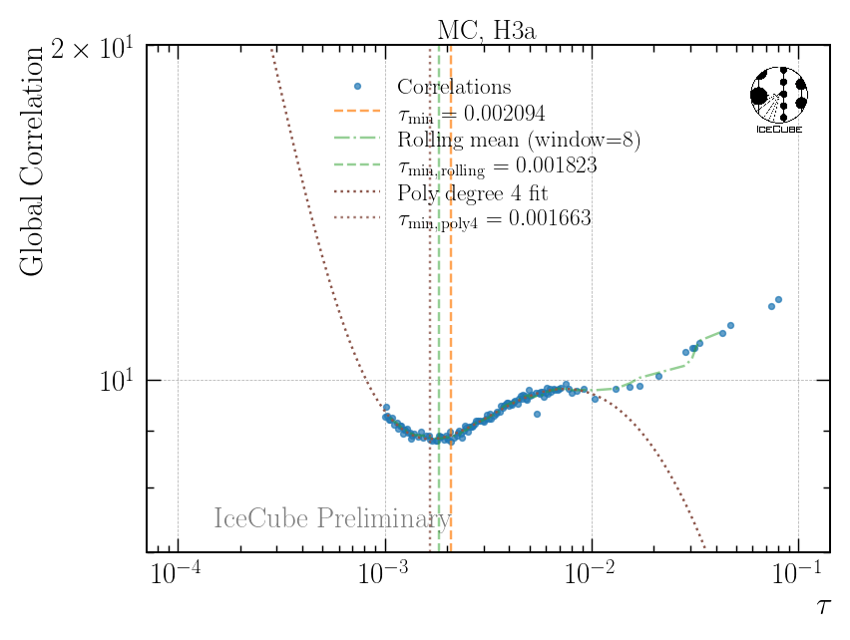
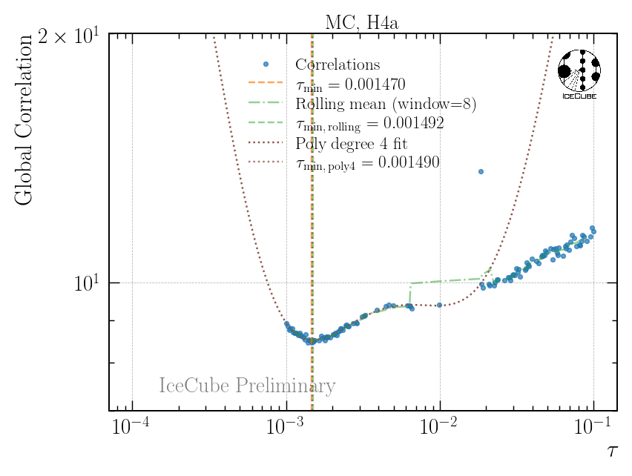
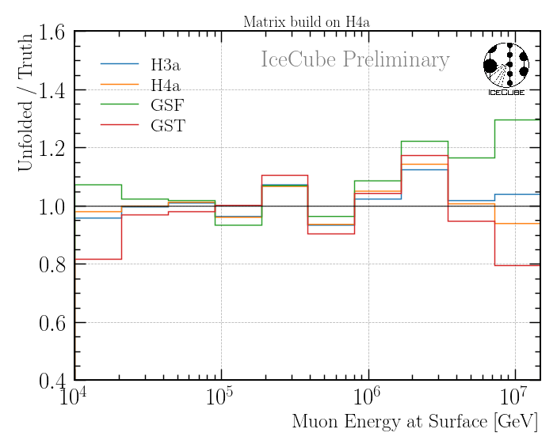
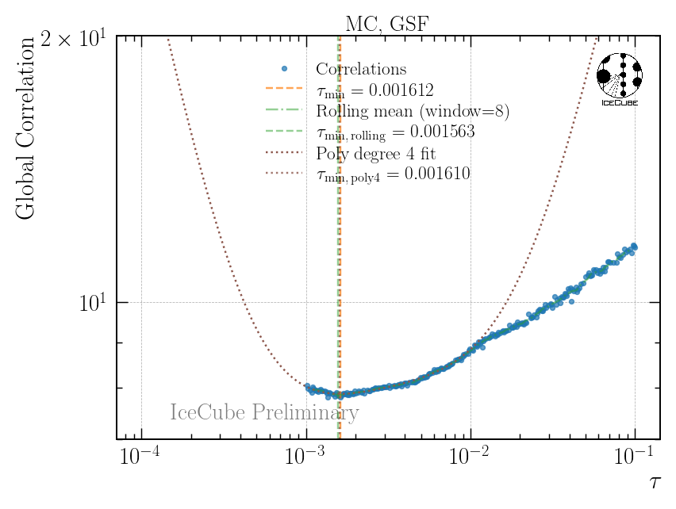

H4a Unfolding Bias
Fit $τ {∈10}^{−3}−{10}^{−2}$

Slide 8
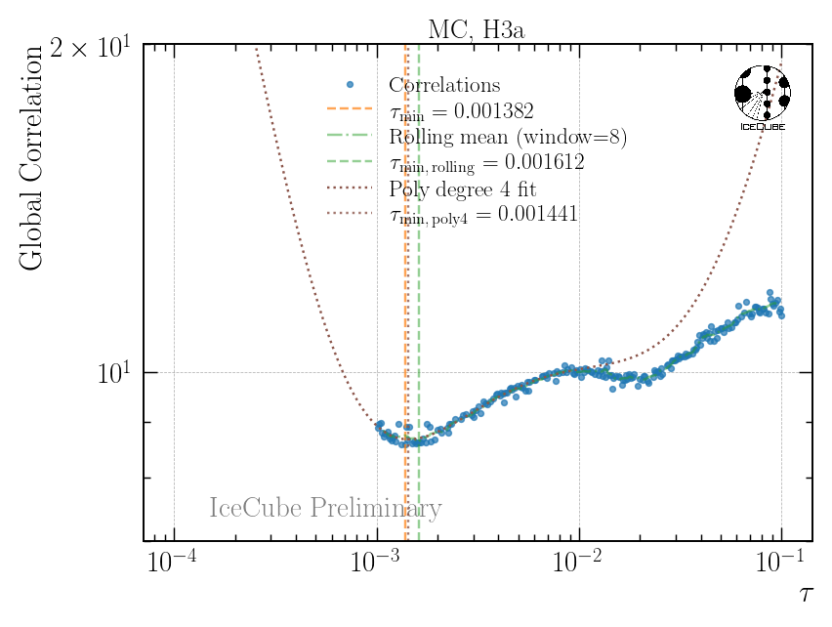
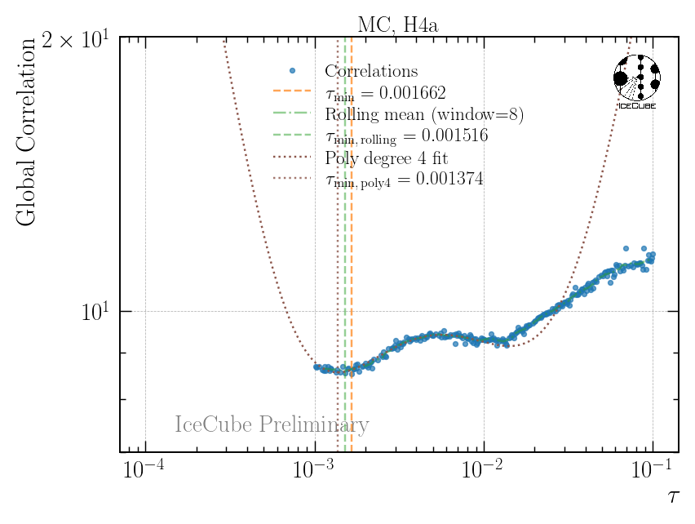
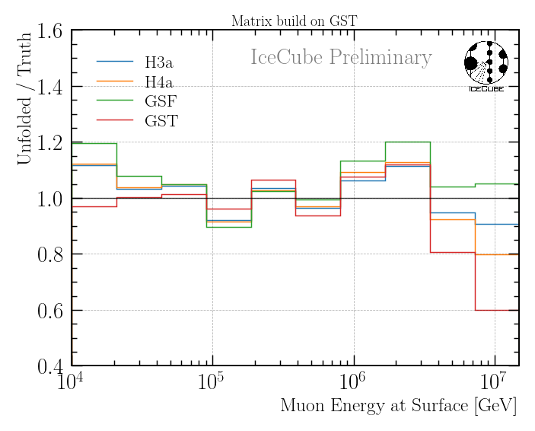
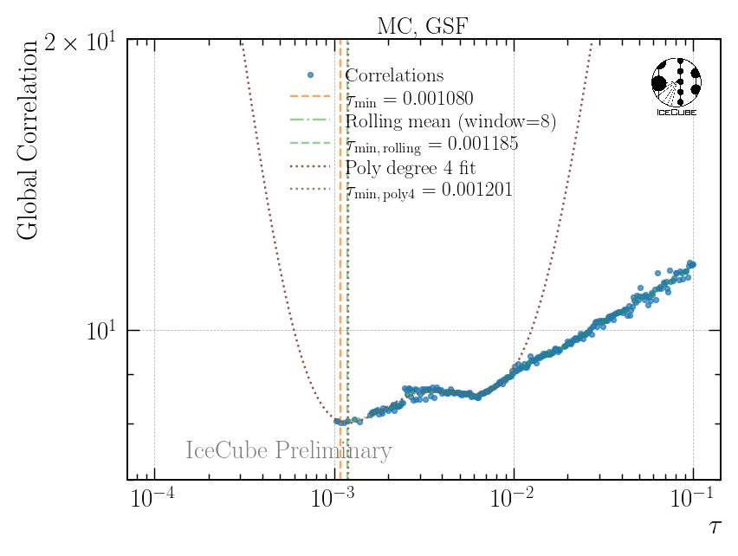
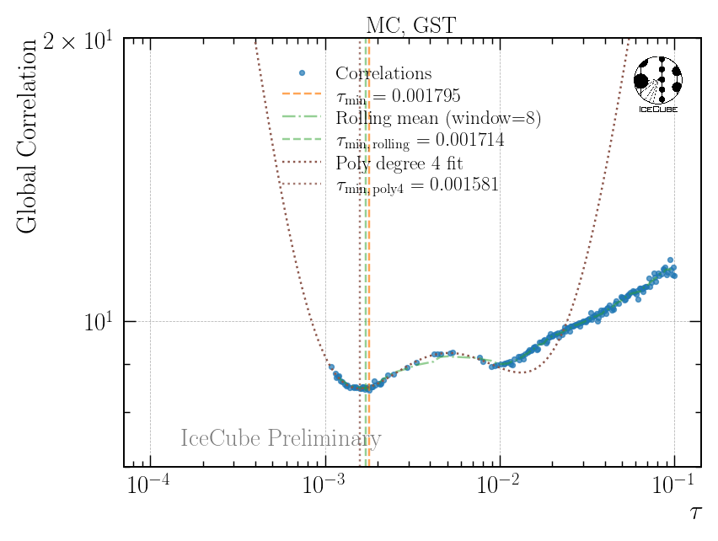
GST Unfolding Bias
Fit $τ {∈10}^{−3}−{10}^{−2}$

Slide 9
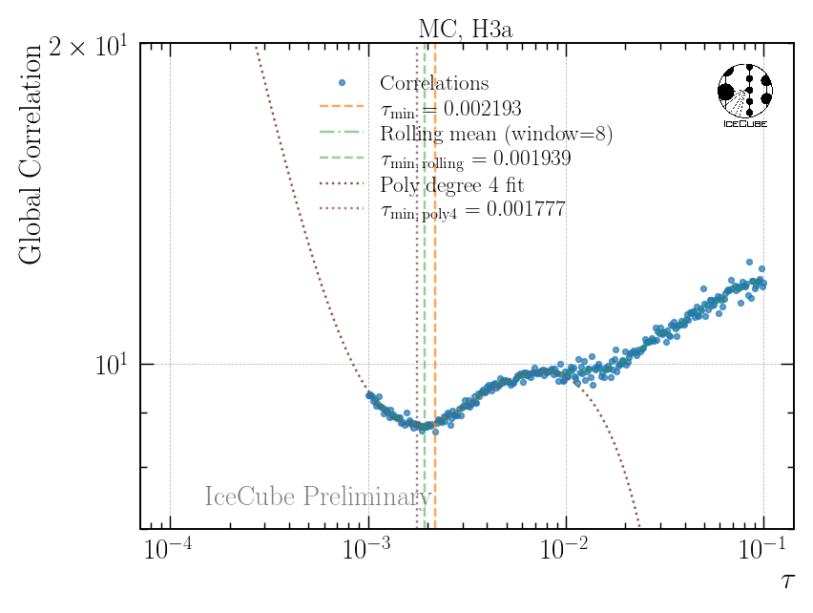
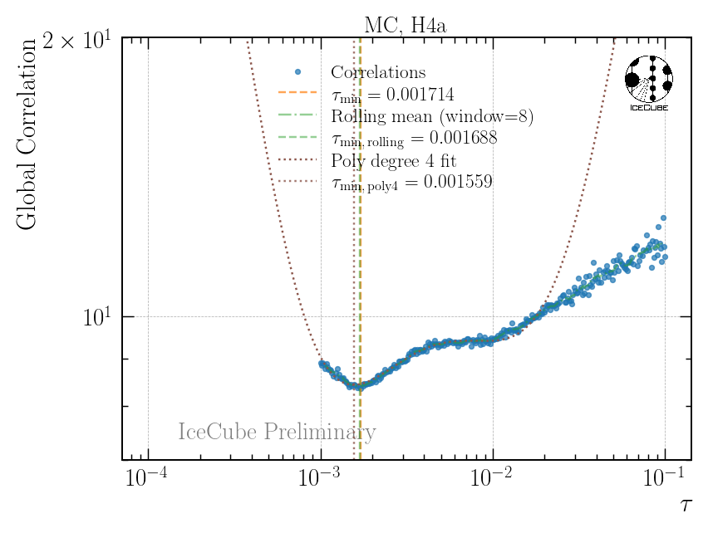
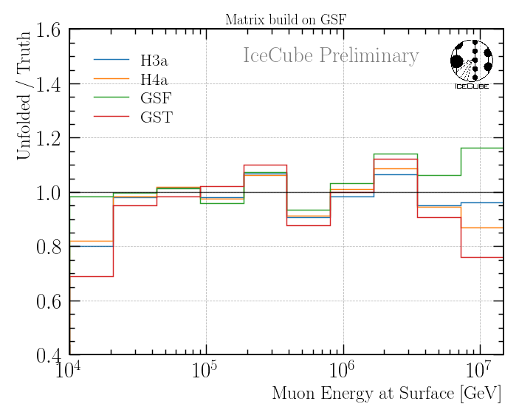
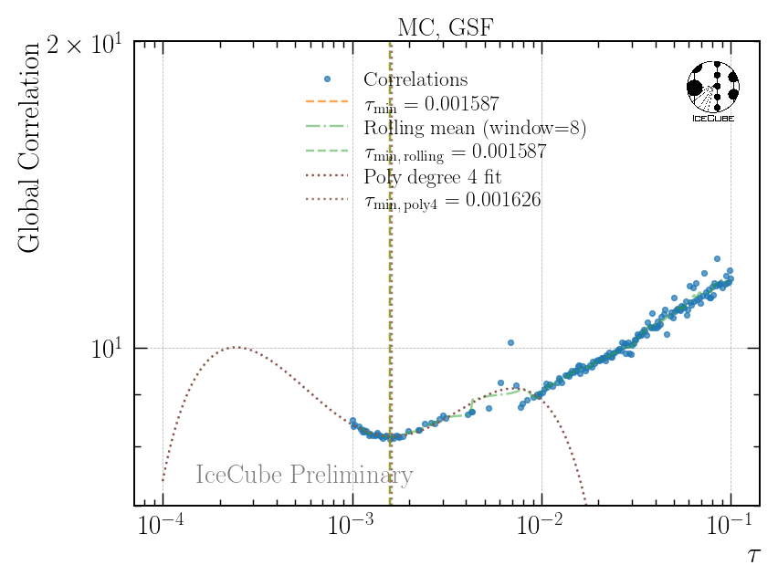

GSF Unfolding Bias
Fit $τ {∈10}^{−3}−{10}^{−2}$

Slide 10
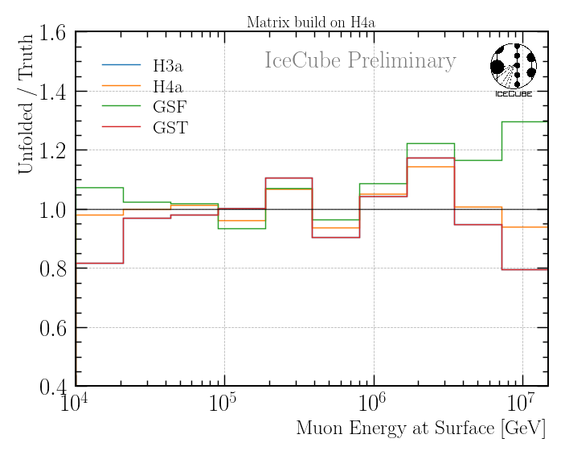
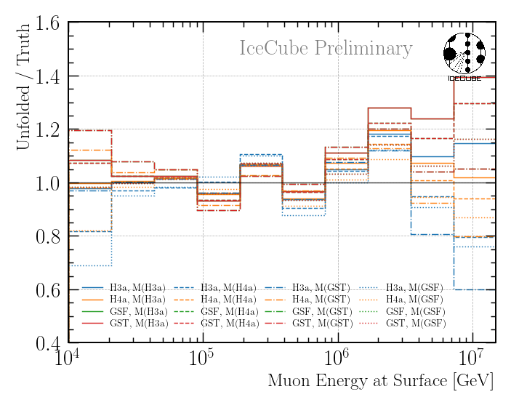
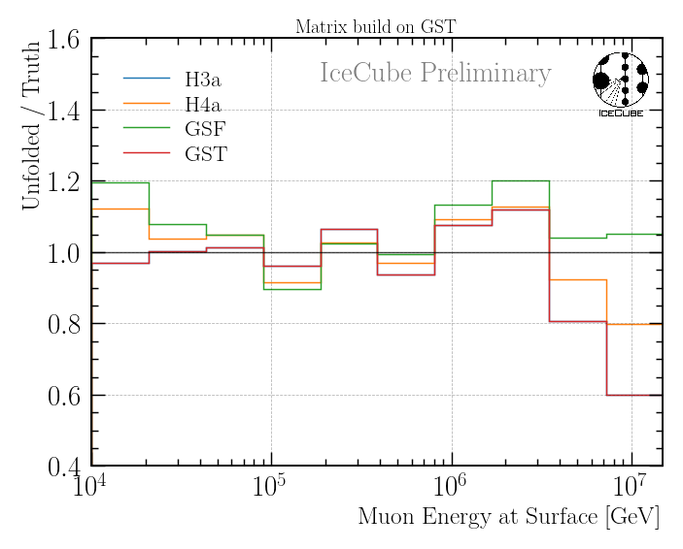

Unfolding Bias for All Models
Summary
Add these biases as an uncertainty to the unfolding result

Slide 11
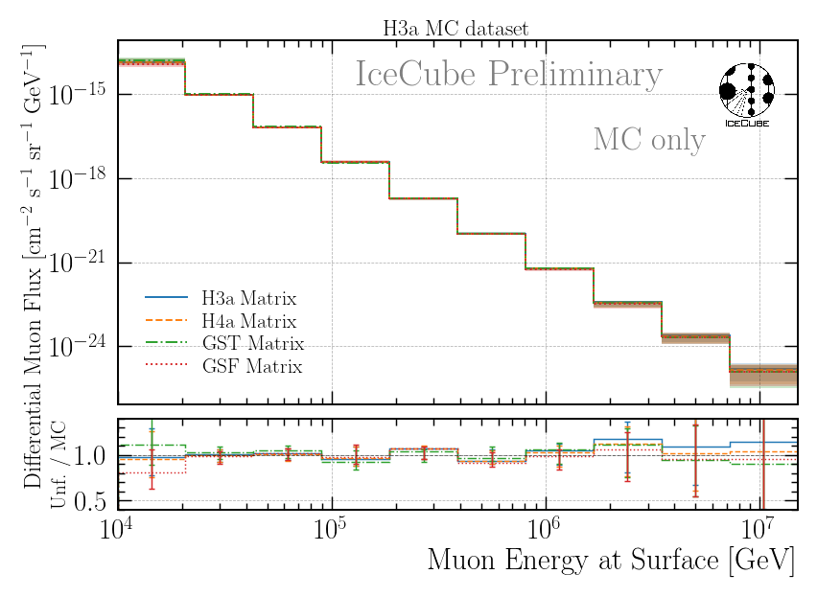
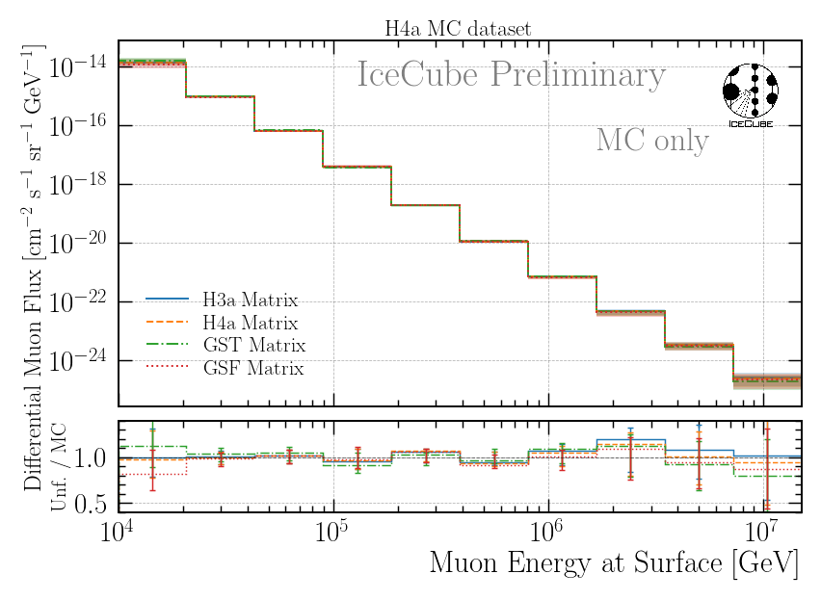
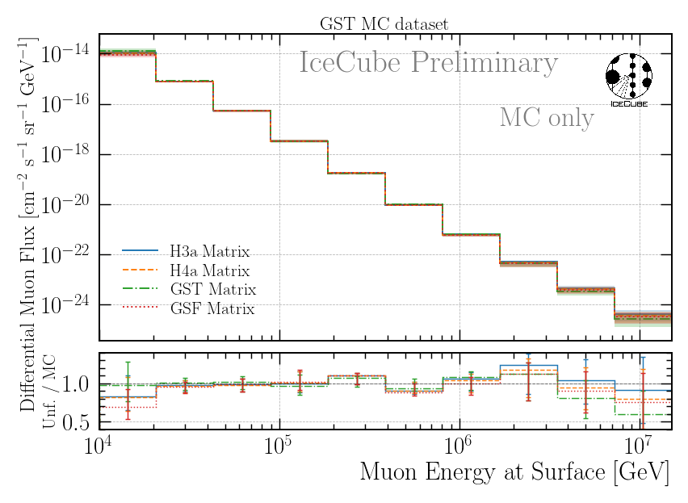
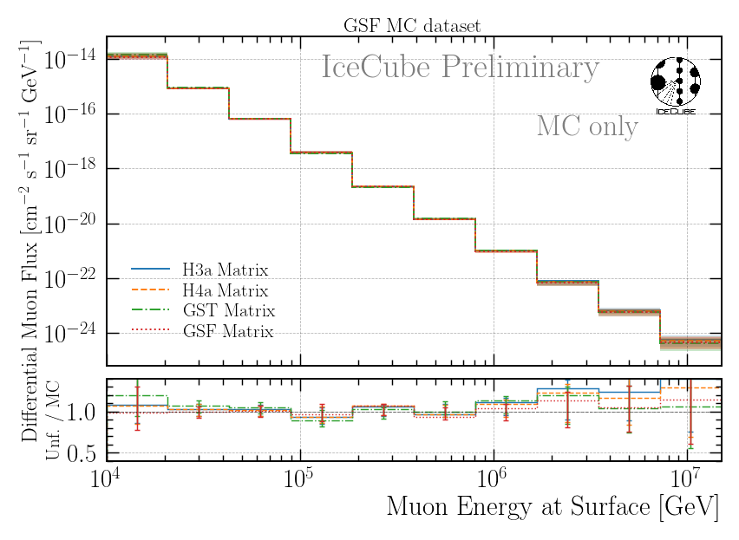
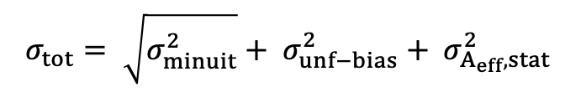
Include Uncertainties
$$σ_{tot}= \sqrt{σ_{minuit}^{2}}+ σ_{unf−bias}^{2}+ σ_{A_{eff},stat }^{2}$$
All 4 test dataset unfoldings agree within the uncertainties with the truth

Slide 12
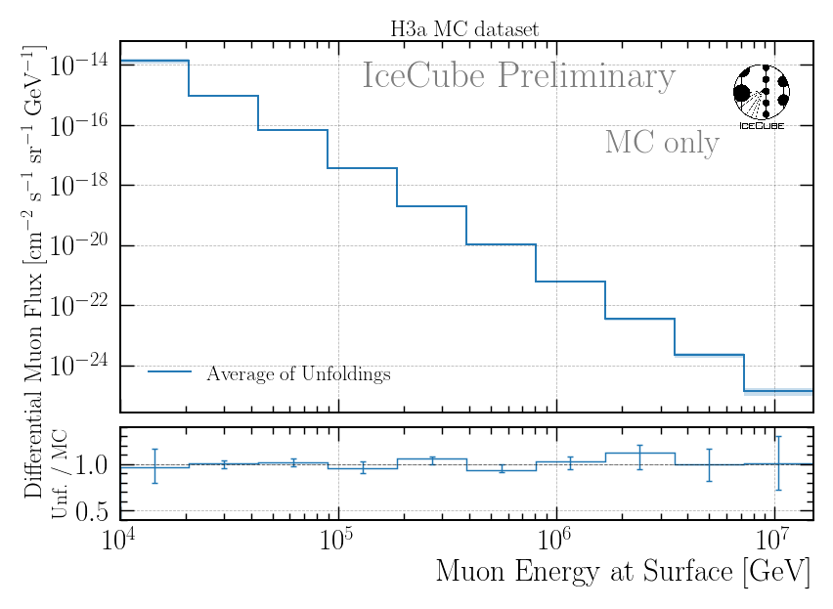
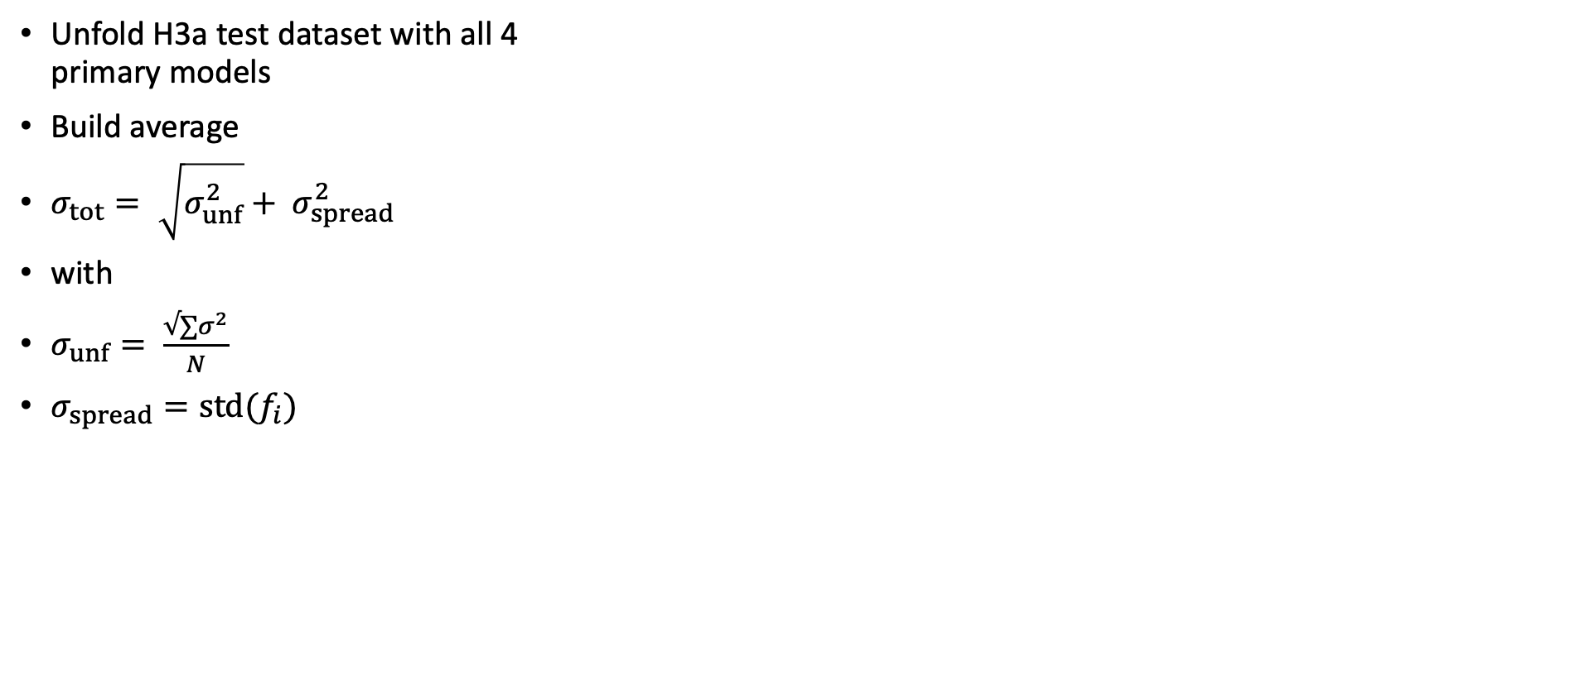
Nominal / Best Fit → Average of 4 Unfoldings
Unfold H3a test dataset with all 4 primary models
Build average
$σ_{tot}= \sqrt{σ_{unf}^{2}}+ σ_{spread}^{2}$
with
$σ_{unf}= \frac{√∑σ^{2}}{N}$
$σ_{spread}=std(f_{i})$

Slide 13
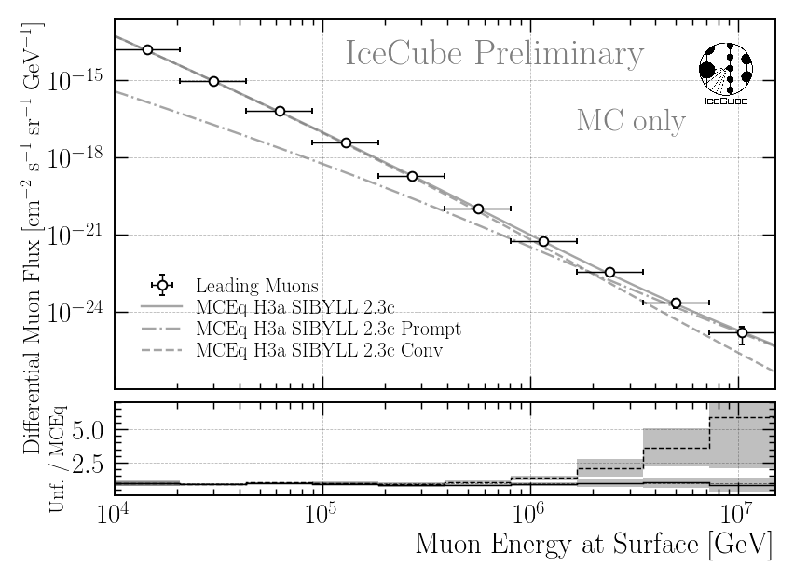

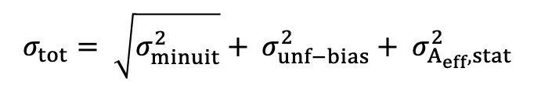
12 Years Prediction
unfolding bias taken from H3a because H3a matrix was used here
symmetric errors
asymmetric errors
$$σ_{tot}= \sqrt{σ_{minuit}^{2}}+ σ_{unf−bias}^{2}+ σ_{A_{eff},stat }^{2}$$

Slide 14


12 Years Prediction
unfolding bias taken from all permutations
symmetric errors
asymmetric errors
$$σ_{tot}= \sqrt{σ_{minuit}^{2}}+ σ_{unf−bias}^{2}+ σ_{A_{eff},stat }^{2}$$

Slide 15
Data-MC Post Fit

Slide 16
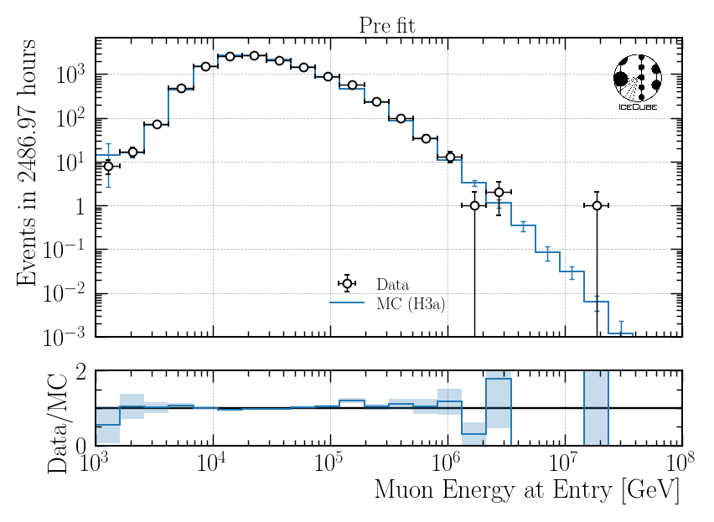
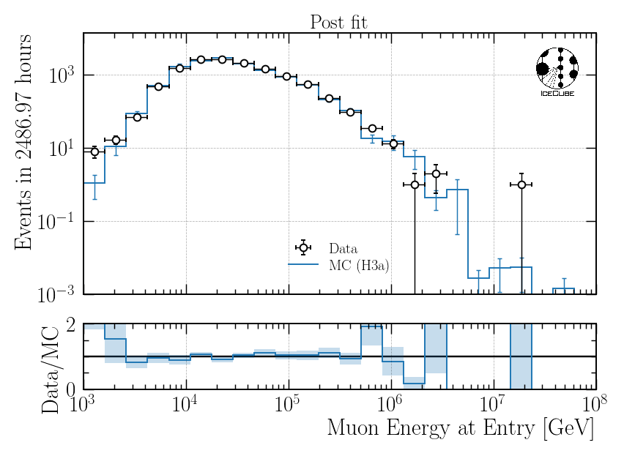
Data-MC: Burnsample
Pre Fit
Post Fit
include entire Snowstorm dataset
re-weight to best fit systematics

Slide 17
Flux Characterization

Slide 18
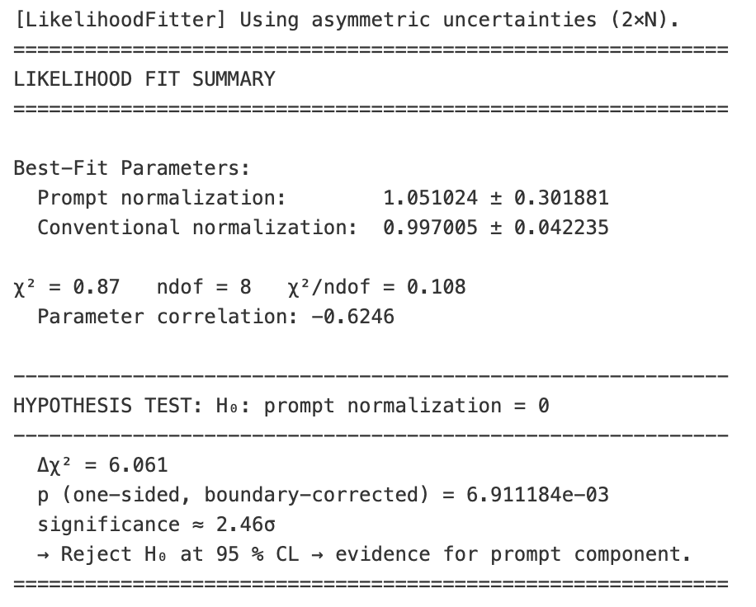

Slide 19
Unblinding Plan

Slide 20
Unblinding Proposal
Unblinding plans
Unfold 12 years of data for IC86 from 2011 to 2022
Determine regularization strength on data
Perform unfolding on data
Build matrix on all 4 primary models
Fit prompt/conv normalization (significance) on all 4 unfoldings each
Build average of all 4 unfoldings → nominal values
Post-unblinding checks
Check the data-MC agreement for proxy variable (leading energy)
pre-fit (on the entire Snowstorm dataset)
post-fit (re-weight to fitted systematics)
Divide total dataset in 3 subsets á 4 years to analyze systematic impacts over the years
Divide dataset into 4 seasons
Paper Proposal
Present status of forward folding in November
If results look promising → cross—checks can be done until end of January next year
Combined forward and unfolding paper: Discovery of prompt?
Elif, forward folding needs much more work
Unfolding paper: Measurement of muon flux
Thank you for your attention!

Slide 21
Backup

Slide 22
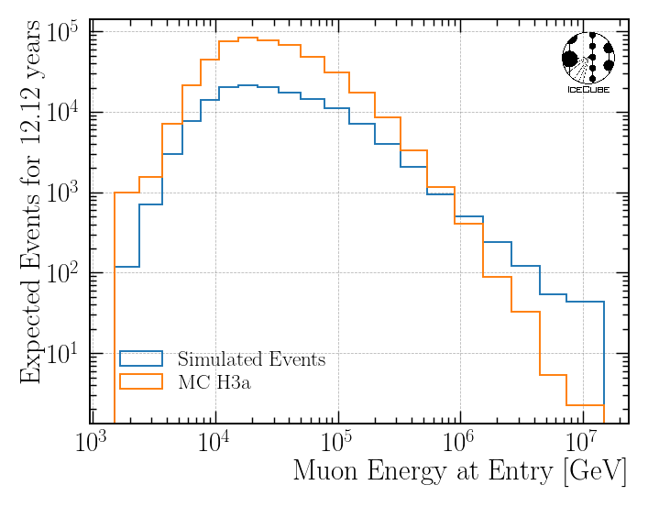
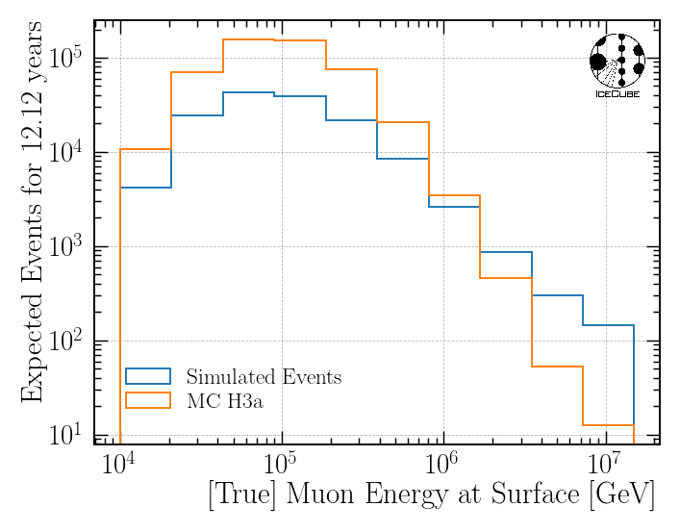
MC Statistics

Slide 23
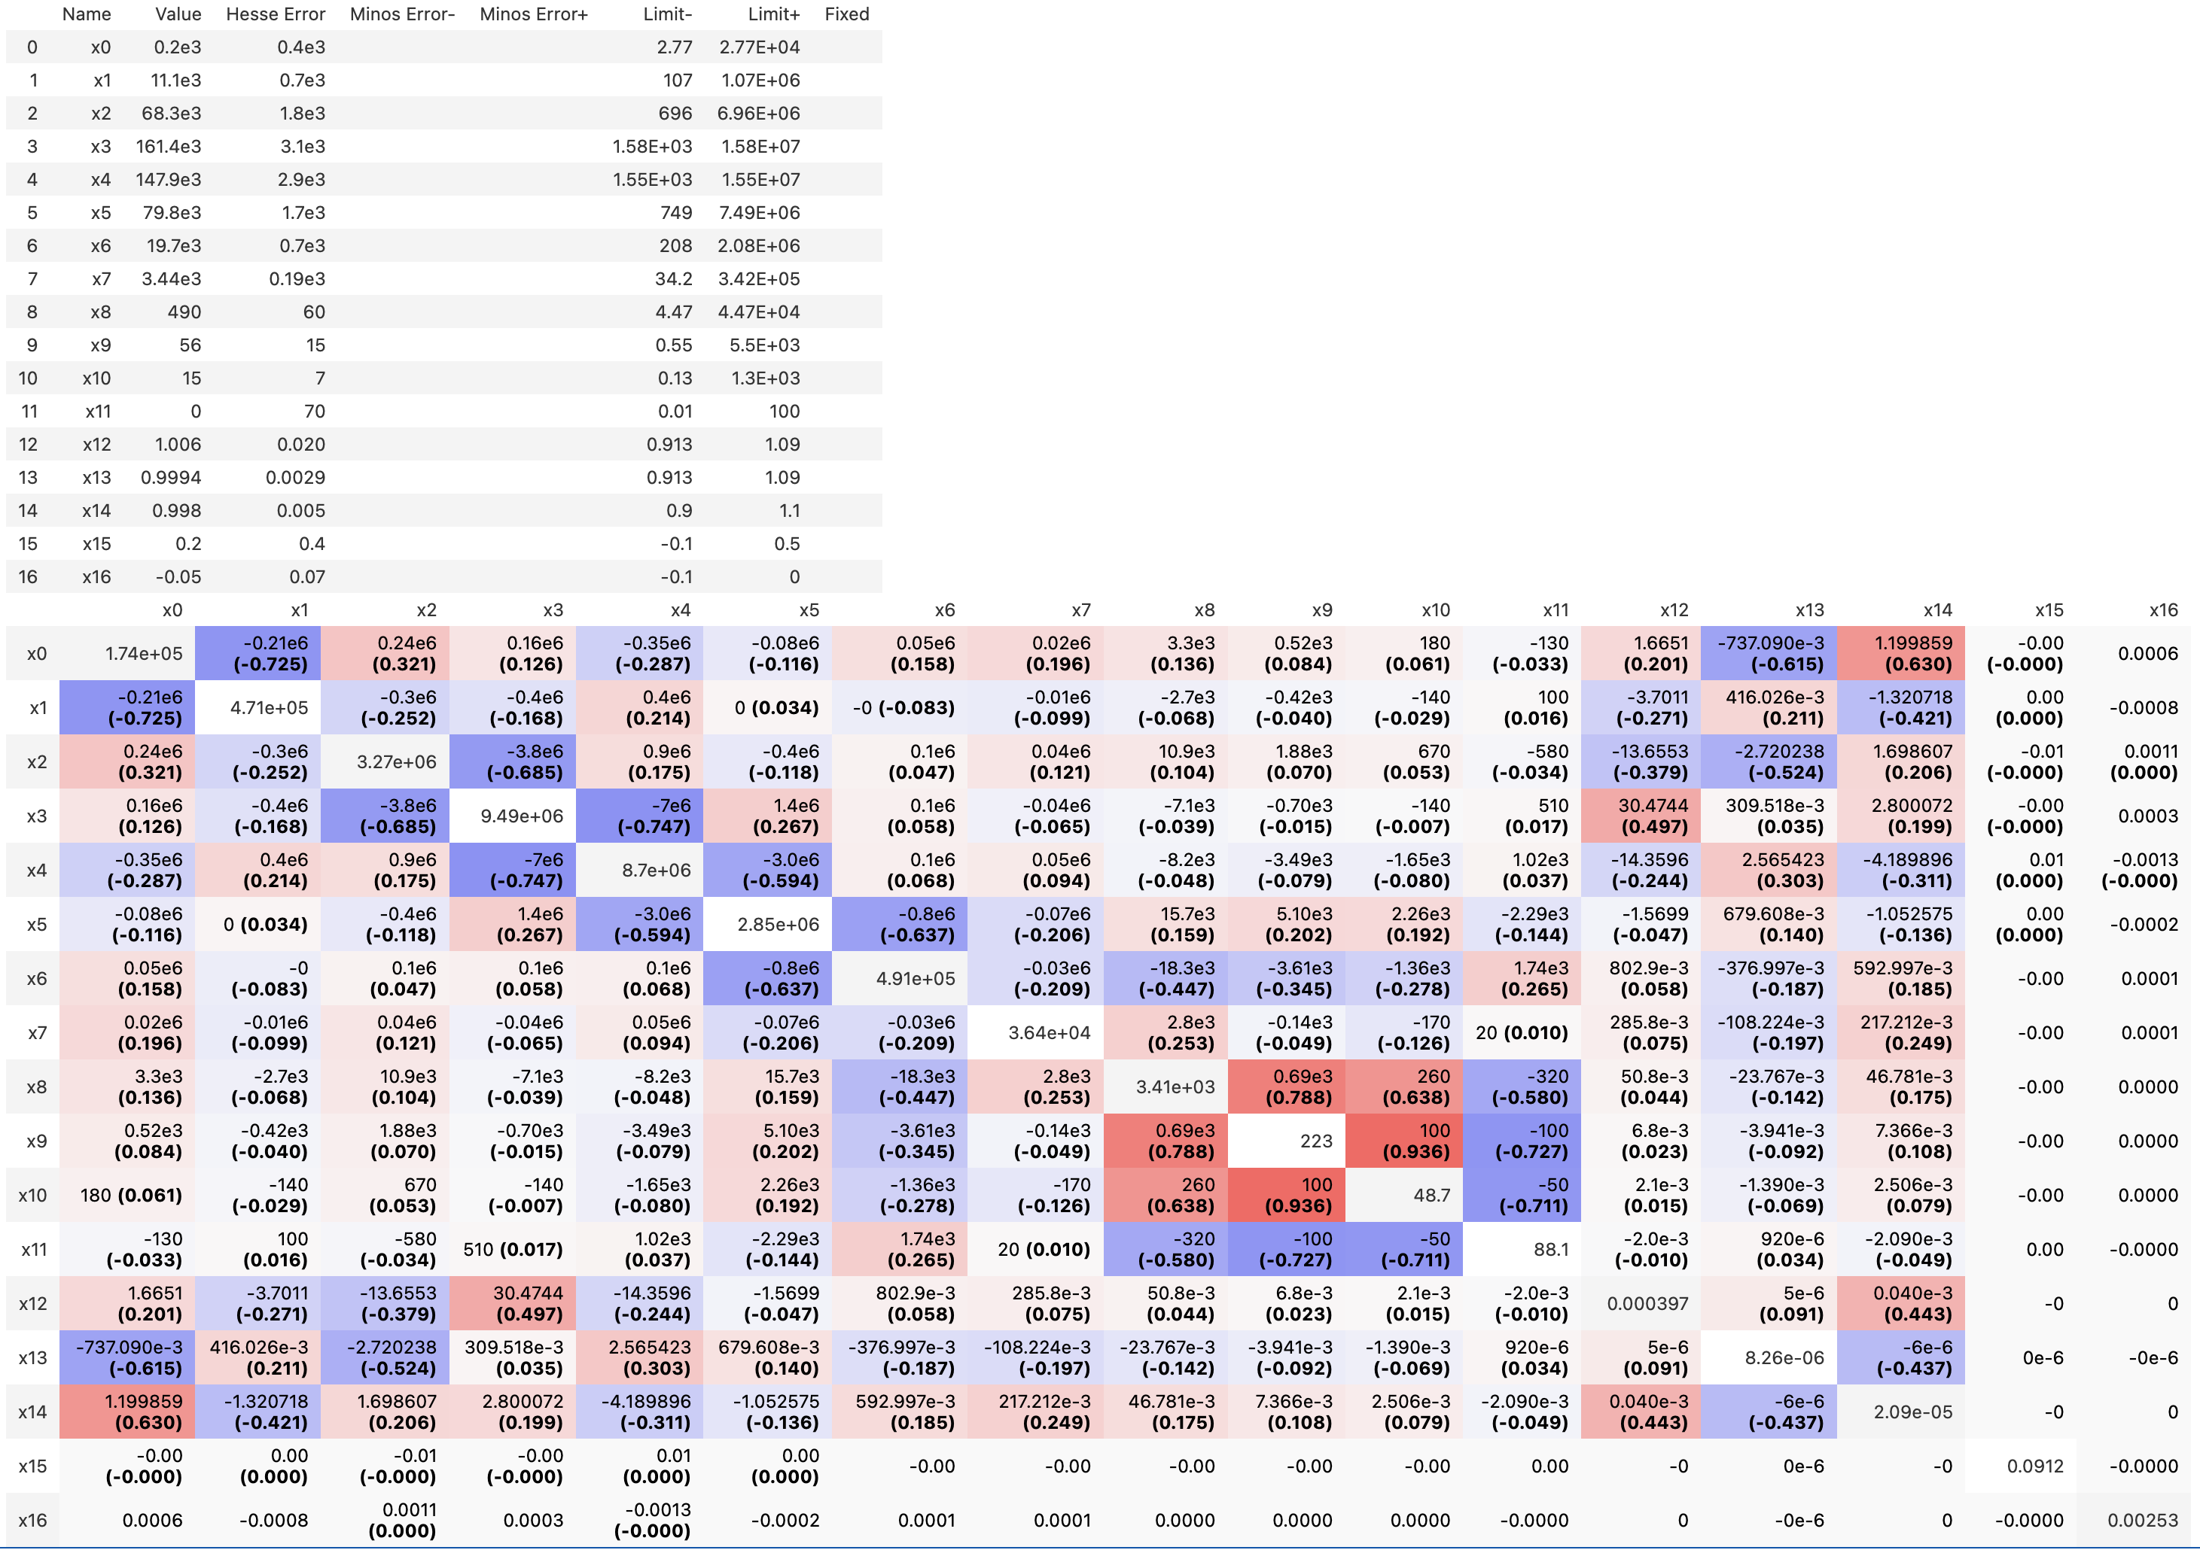
Minuit output

Slide 24

Introduction
Motivation
Characterize muon flux components and depth intensity
Probe hadronic interactions in the atmosphere
Constrain uncertainties and longstanding questions like the “muon puzzle”
Long term
Enhance understanding of hadronic processes relevant in distant astrophysical sources (e.g., supernovae, AGNs, …)
$φ_{tot}=φ_{prompt}+$ $φ_{conventional}$
Conventional Muon:
Parent is pion or kaon
Credit: Ludwig Neste

Slide 25
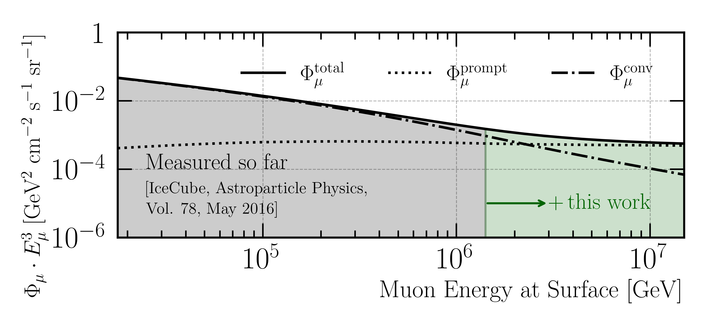
Goal: Measure Muon Flux at Surface
MCEq: SIBYLL 2.3d (H3a)

Slide 26
Overview
Simulation
Reconstruction
Selection
Unfolding
Dataset
CORSIKA 77500 Ehist
SIBYLL 2.3d
10 TeV – 100 EeV
Snowstorm
DNN reconstructions
Muon energies
Muon direction
Track geometry
Level 3
L2 muon filter
Add labels
Muon spectrum
Unfold muon flux at surface
Level 4
500 TeV bundle energy cut at surface
Add DNN reconstructions
Validation
Tag prompt / conv particles
MCEq comparisons
Level 5
Data-MC quality cuts
Final Level
Leadingness cut

Slide 27
New CORSIKA simulation
with extended history option for information about the parent particles

Slide 28
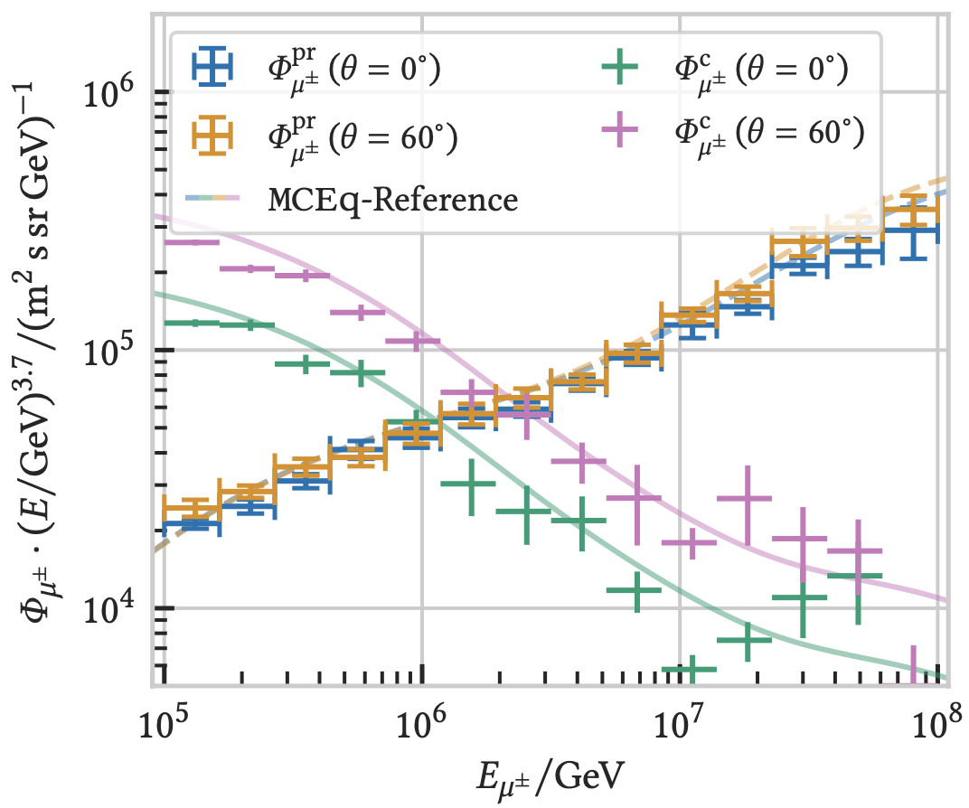

CORSIKA 7 vs. MCEq
MCEq: tool to numerically solve the cascade equations that describes the evolution of particle densities as they propagate through a gaseous, dense medium
https://github.com/mceq-project/MCEq
Good agreement for inclusive flux
Python package developed – PANAMA
Execute CORSIKA 7 (multi core)
Read DAT files → pandas DataFrames
Parse EHIST option
Calculate primary weightings
https://github.com/The-Ludwig/PANAMA
Neste & Gutjahr et al., EPJ C, 85, 759 (2025)

Slide 29
Reconstruction
Machine Learning (CNN)

Slide 30
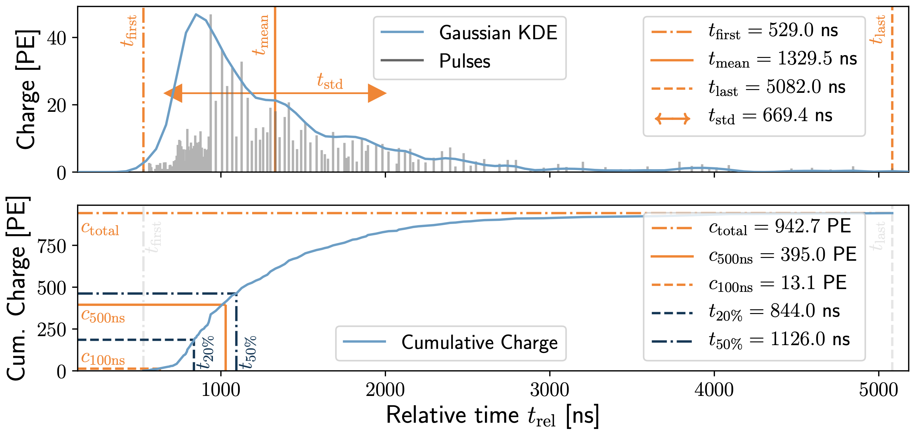
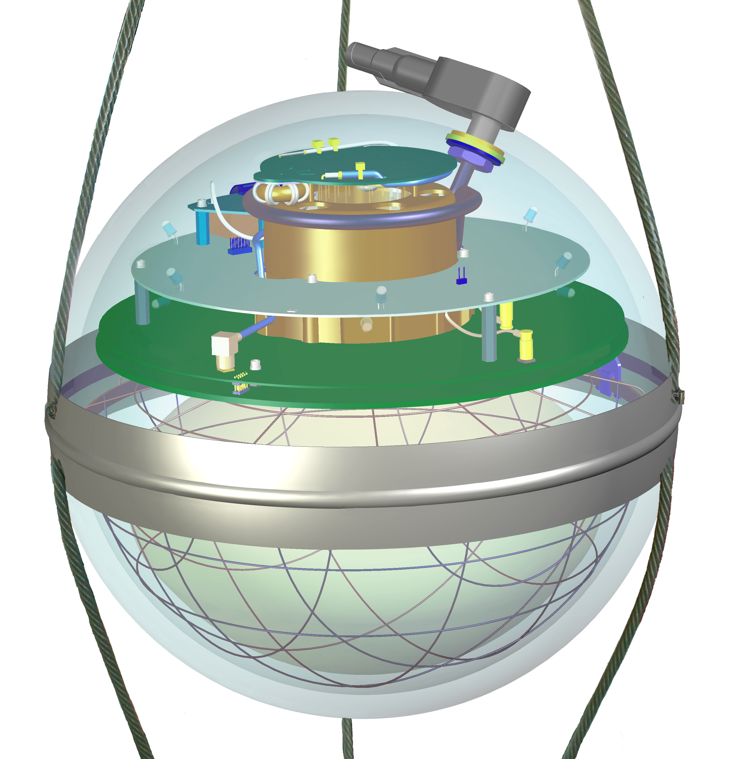
Input data per DOM
10.1088/1748-0221/16/07/P07041
3 inputs
c_{total}: Total charge
Sum of charge
t_{first}: Relative time of first pulse
Relative to total time offset, calculated as the charge weighted mean time of all pulses
t_{std}: Standard deviation of first pulse
Charge weighted standard deviation of pulse times relative to total time offset
9 inputs
t_{last}: Relative time of last pulse
Relative to total time offset, calculated as the charge weighted mean time of all pulses
t_{20%}: Relative time of 20% charge
Relative to total time offset, calculated as the charge weighted mean time of all pulses
t_{50%}: Relative time of 50% charge
Relative to total time offset, calculated as the charge weighted mean time of all pulses
t_{mean}: Mean time
Charge weighted mean time of all pulses relative to total time offset
c_{500ns}: Charge at 500ns
Sum of charge after 500ns
c_{100ns}: Charge at 100ns
Sum of charge after 100ns
Input pulse cleaning
6000 ns
Training data
Different simulations for robustness
Credit: IceCube

Slide 31
Reconstructed properties
Energy
entry_energy: Leading muon energy at the detector entry
bundle_energy_at_entry: Muon bundle energy at the detector entry
muon_energy_first_mctree: Leading muon energy at surface
bundle_energy_in_mctree: Muon bundle energy at surface
Track geometry
Length: Propagation length of muon in the ice
LengthInDetector: Propagation length of muon in the detector
center_pos_x: Closest x position of muon to center of the detector
center_pos_y: Closest y position of muon to center of the detector
center_pos_z: Closest z position of muon to center of the detector
center_pos_t: Time of closest approach to the center of the detector
entry_pos_x: x position of muon at the detector entry
entry_pos_y: y position of muon at the detector entry
entry_pos_z: z position of muon at the detector entry
entry_pos_t: Time of muon at the detector entry
Direction
zenith: Zenith angle of muon
azimuth: Azimuth angle of muon
Network 1
Network 0: Muon bundle energy at surface (fast pre-cut)
Network 2
Network 3

Slide 32
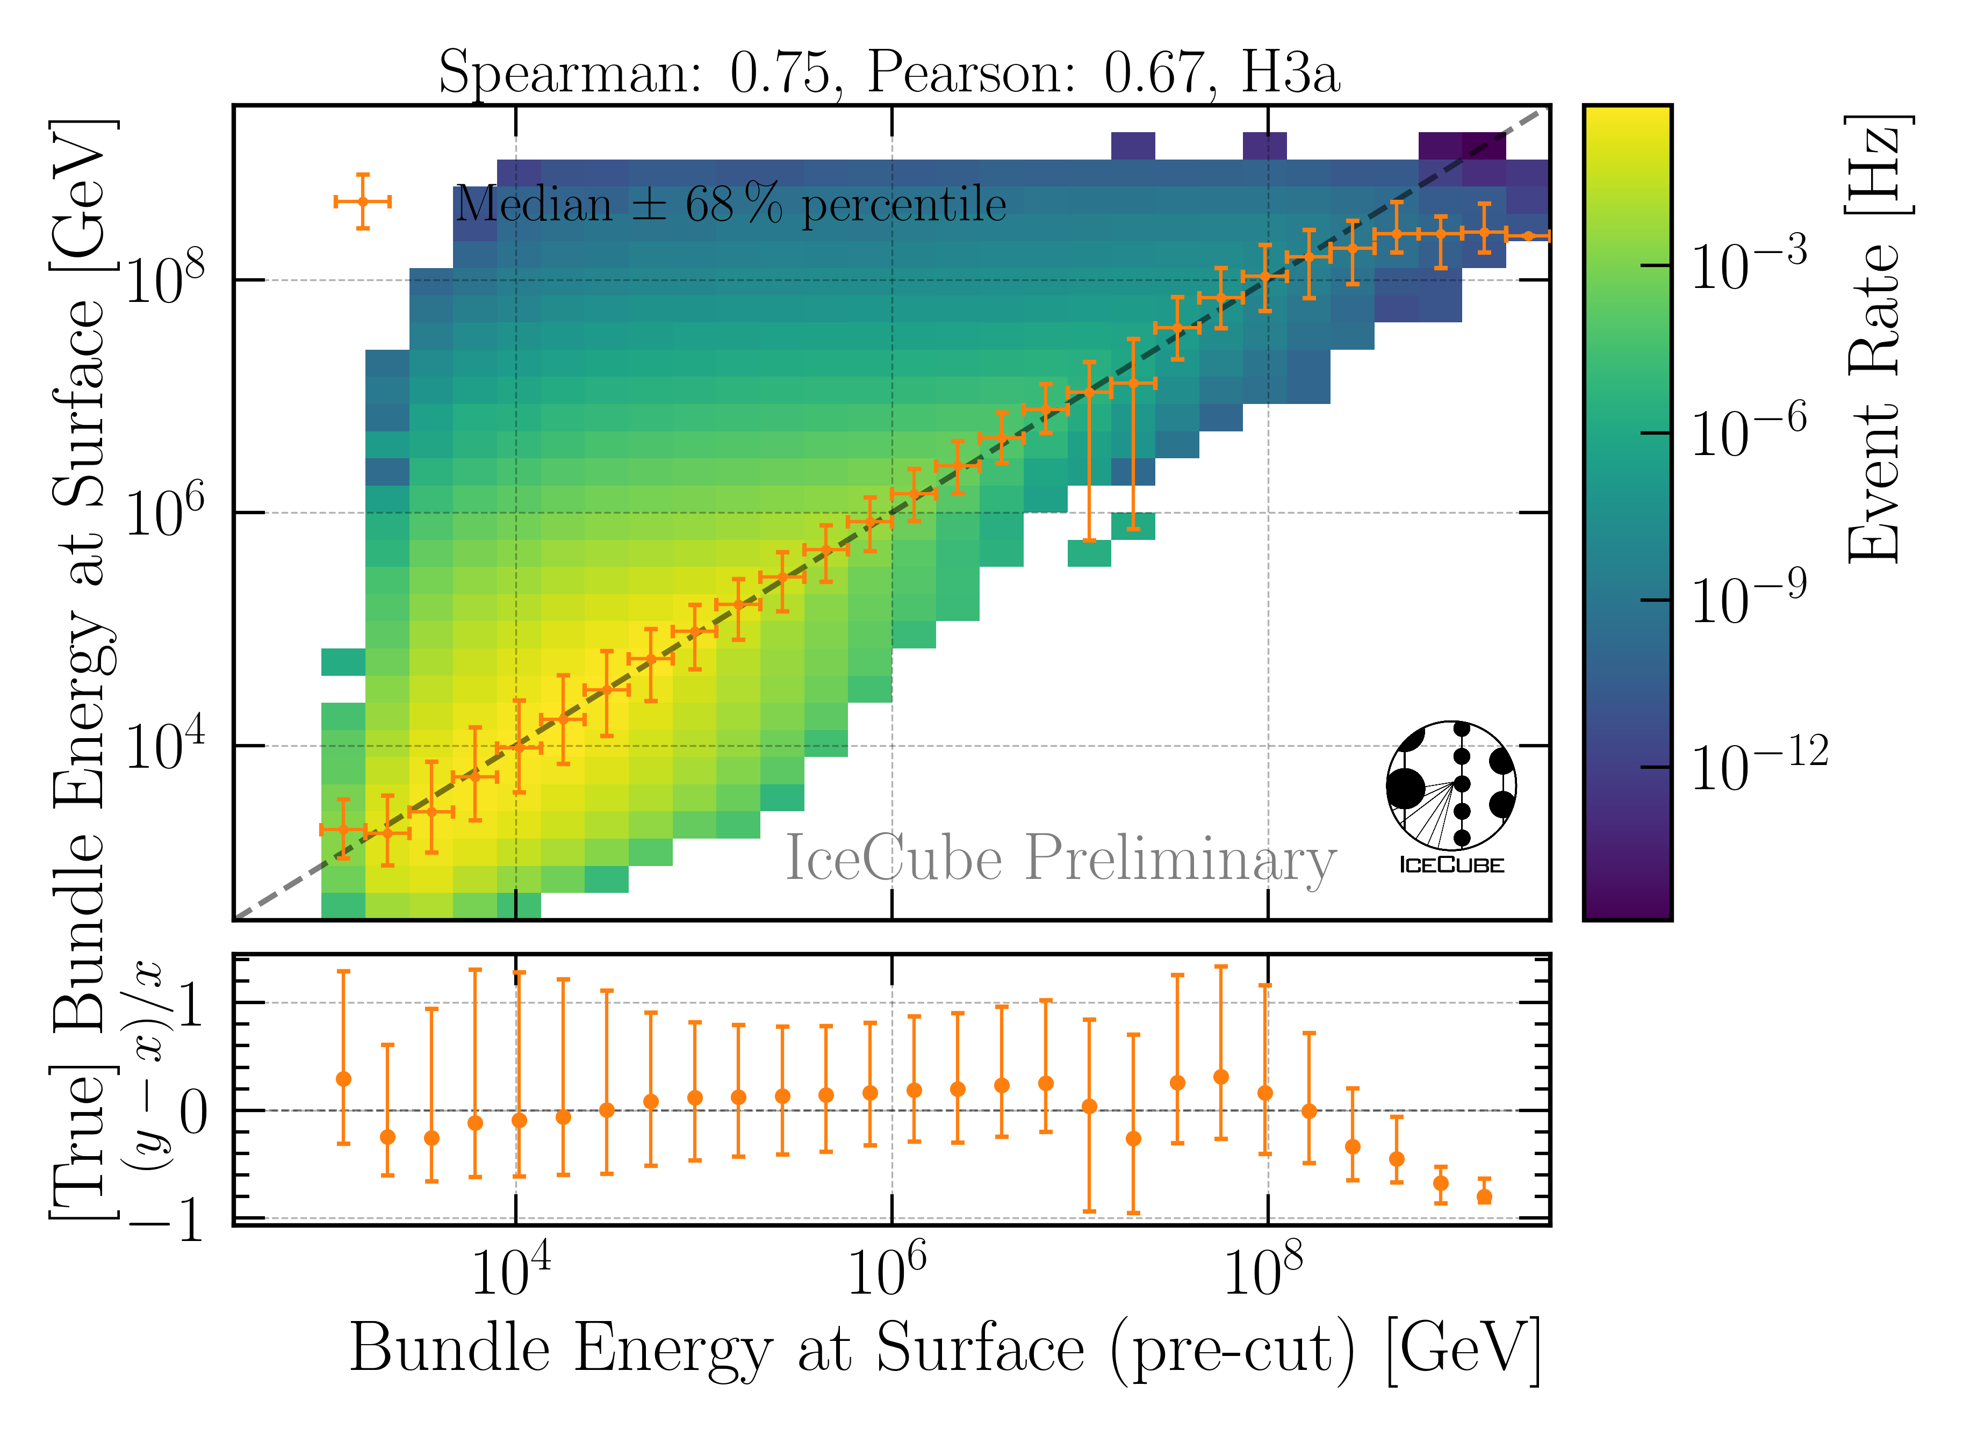
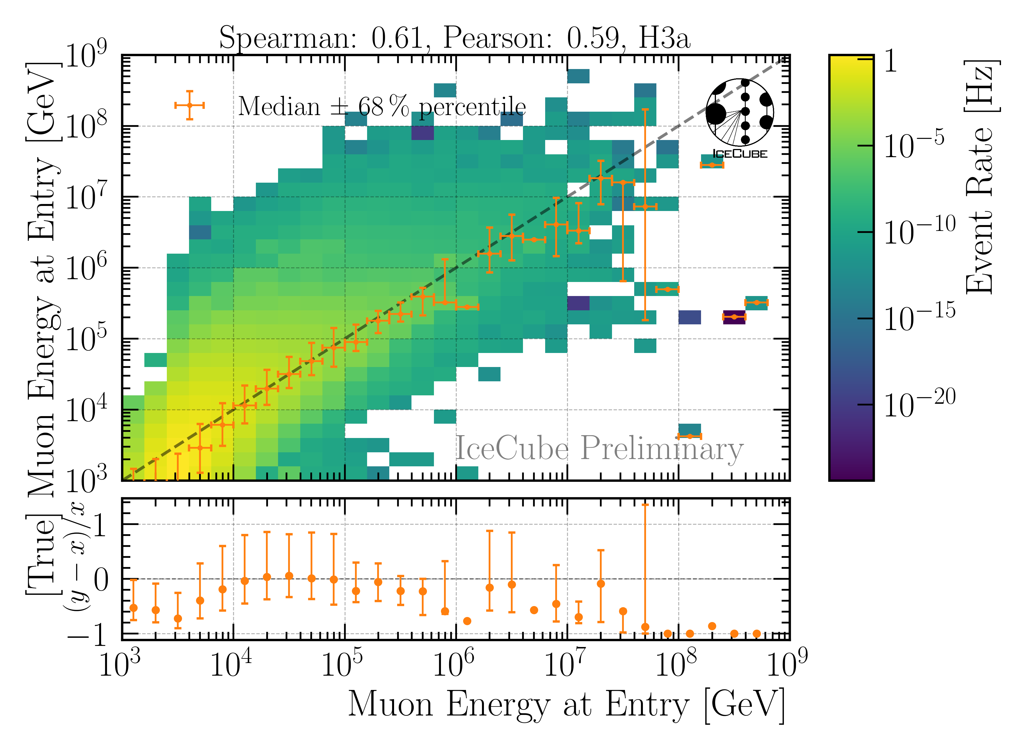
Energy Reconstructions
performed on Level 3 (explained later)
Sufficient energy reconstructions
Tight 68 % intervals, with outliers

Slide 33
Selection

Slide 34
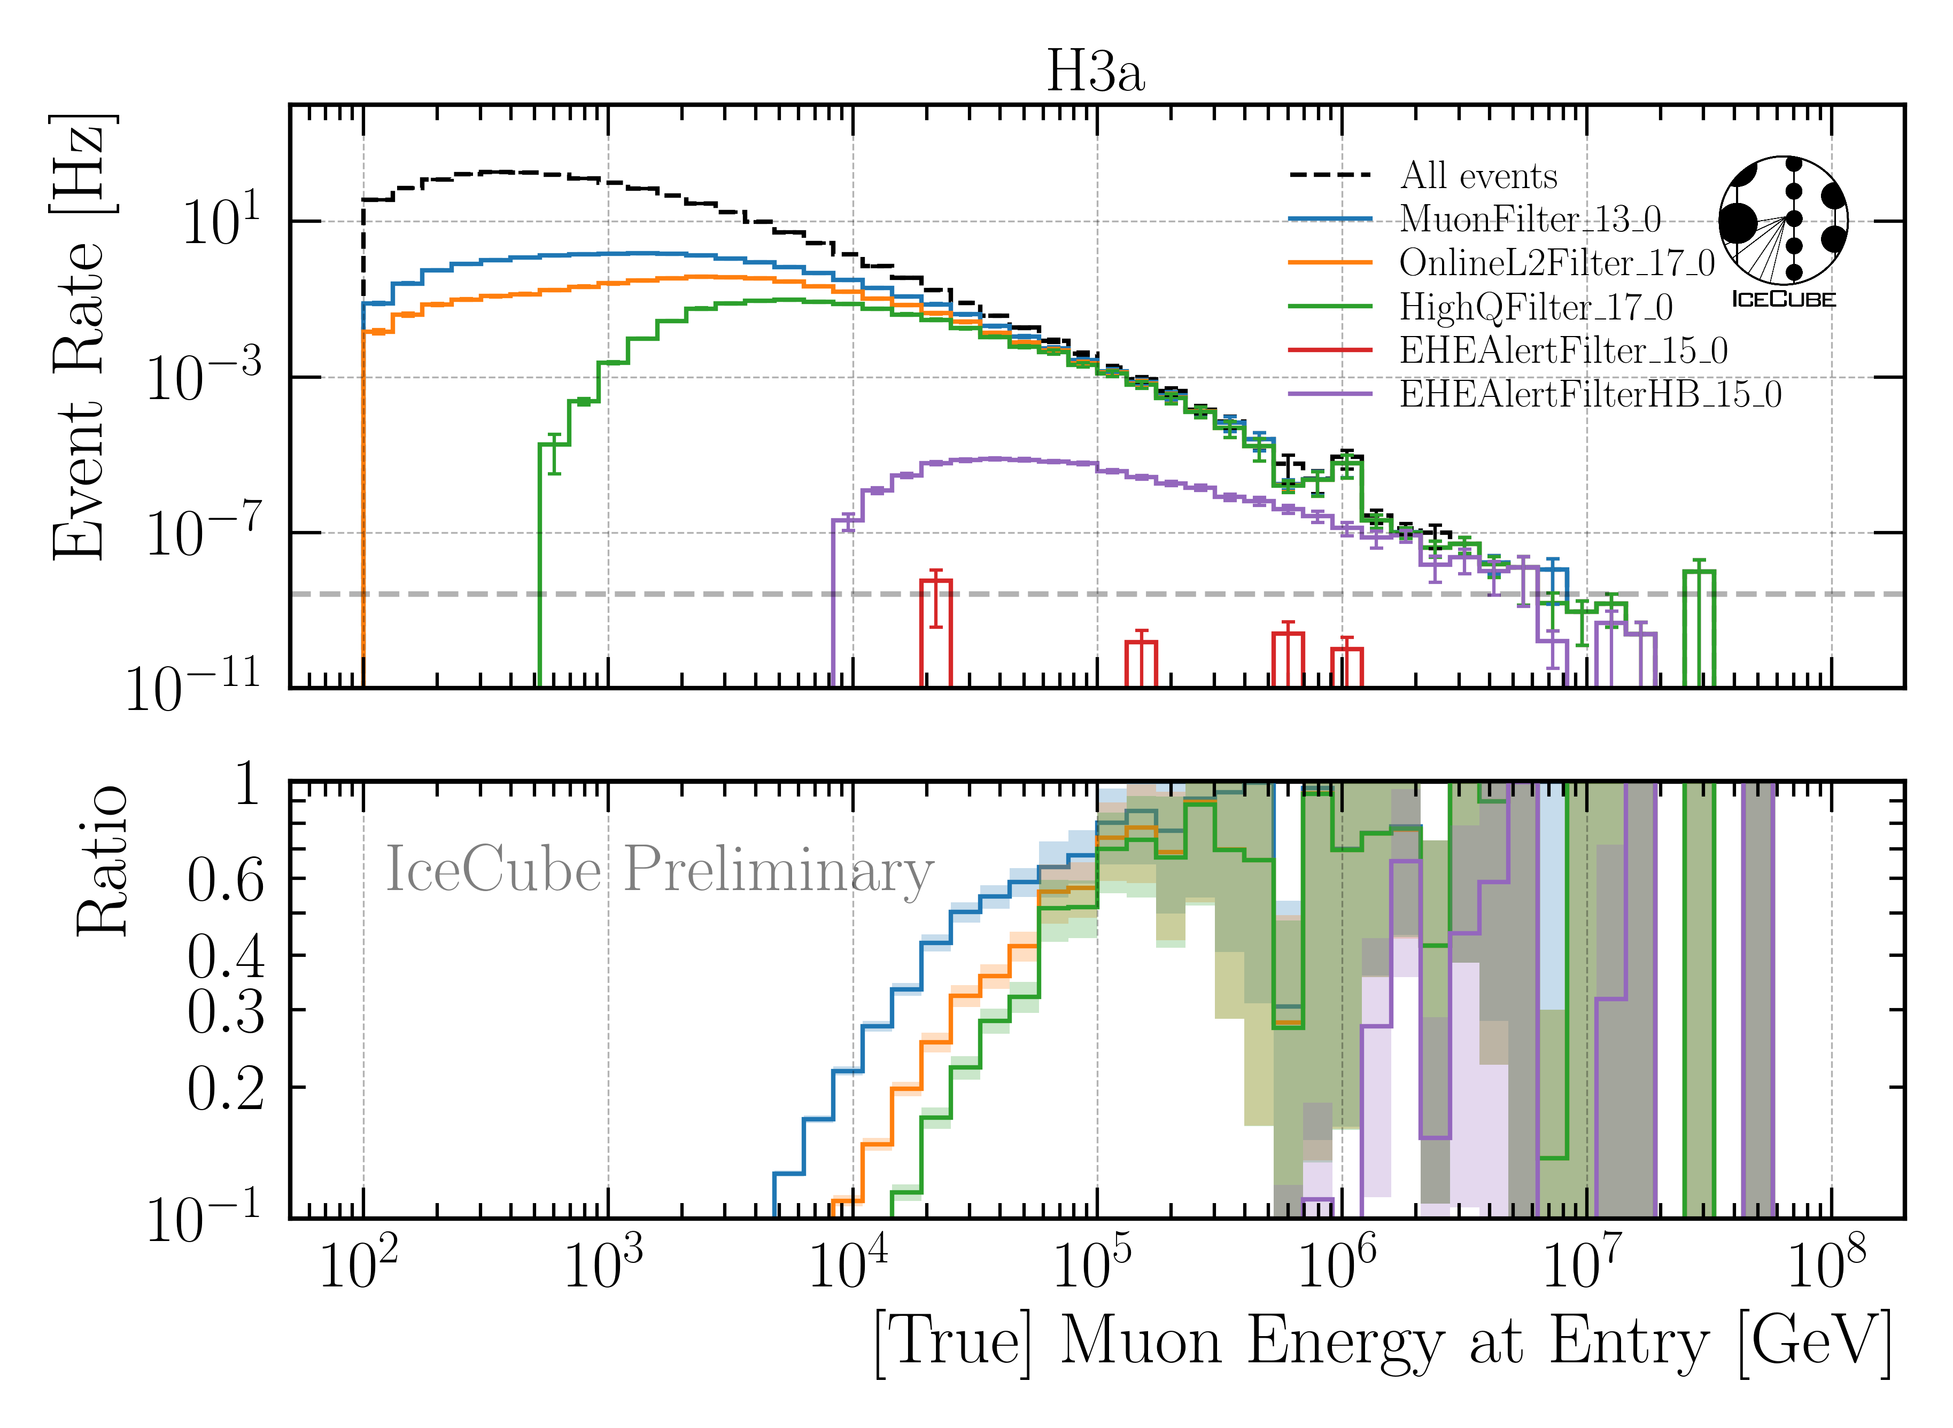
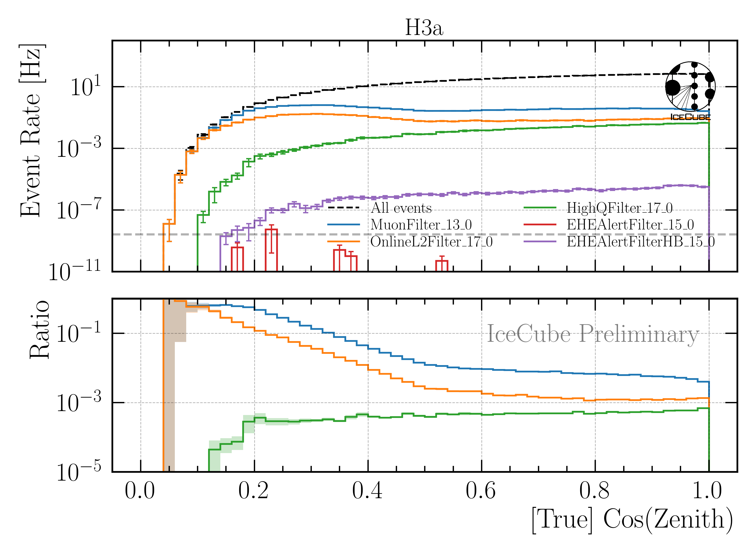
Level 3: Muon Filter
Muon filter: zenith-dependent charge and quality cut
Choose muon filter to select as many high-energy muons as possible

Slide 35
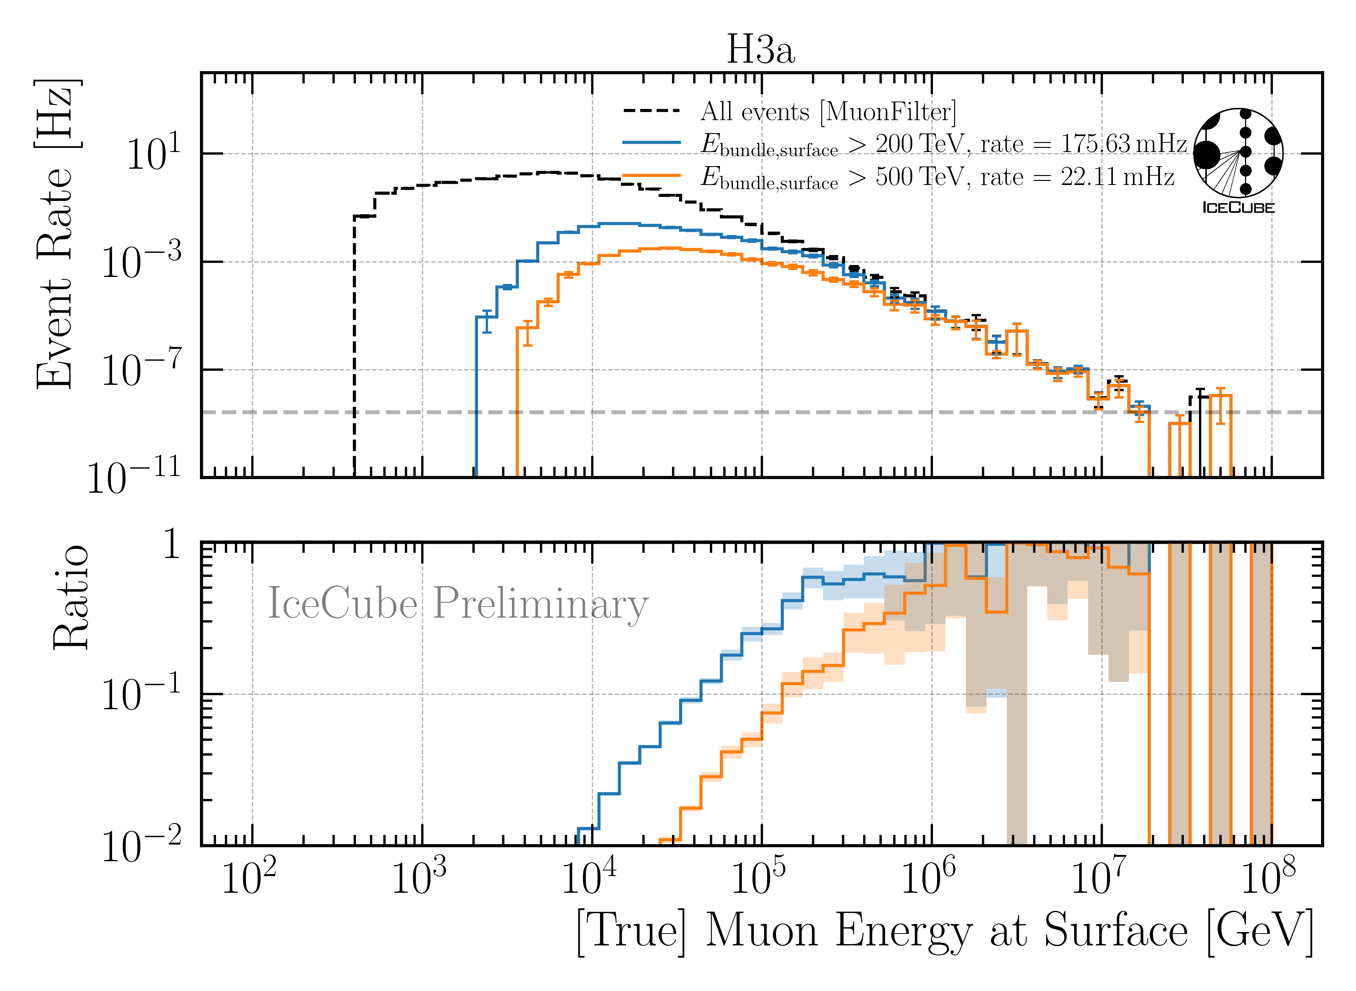
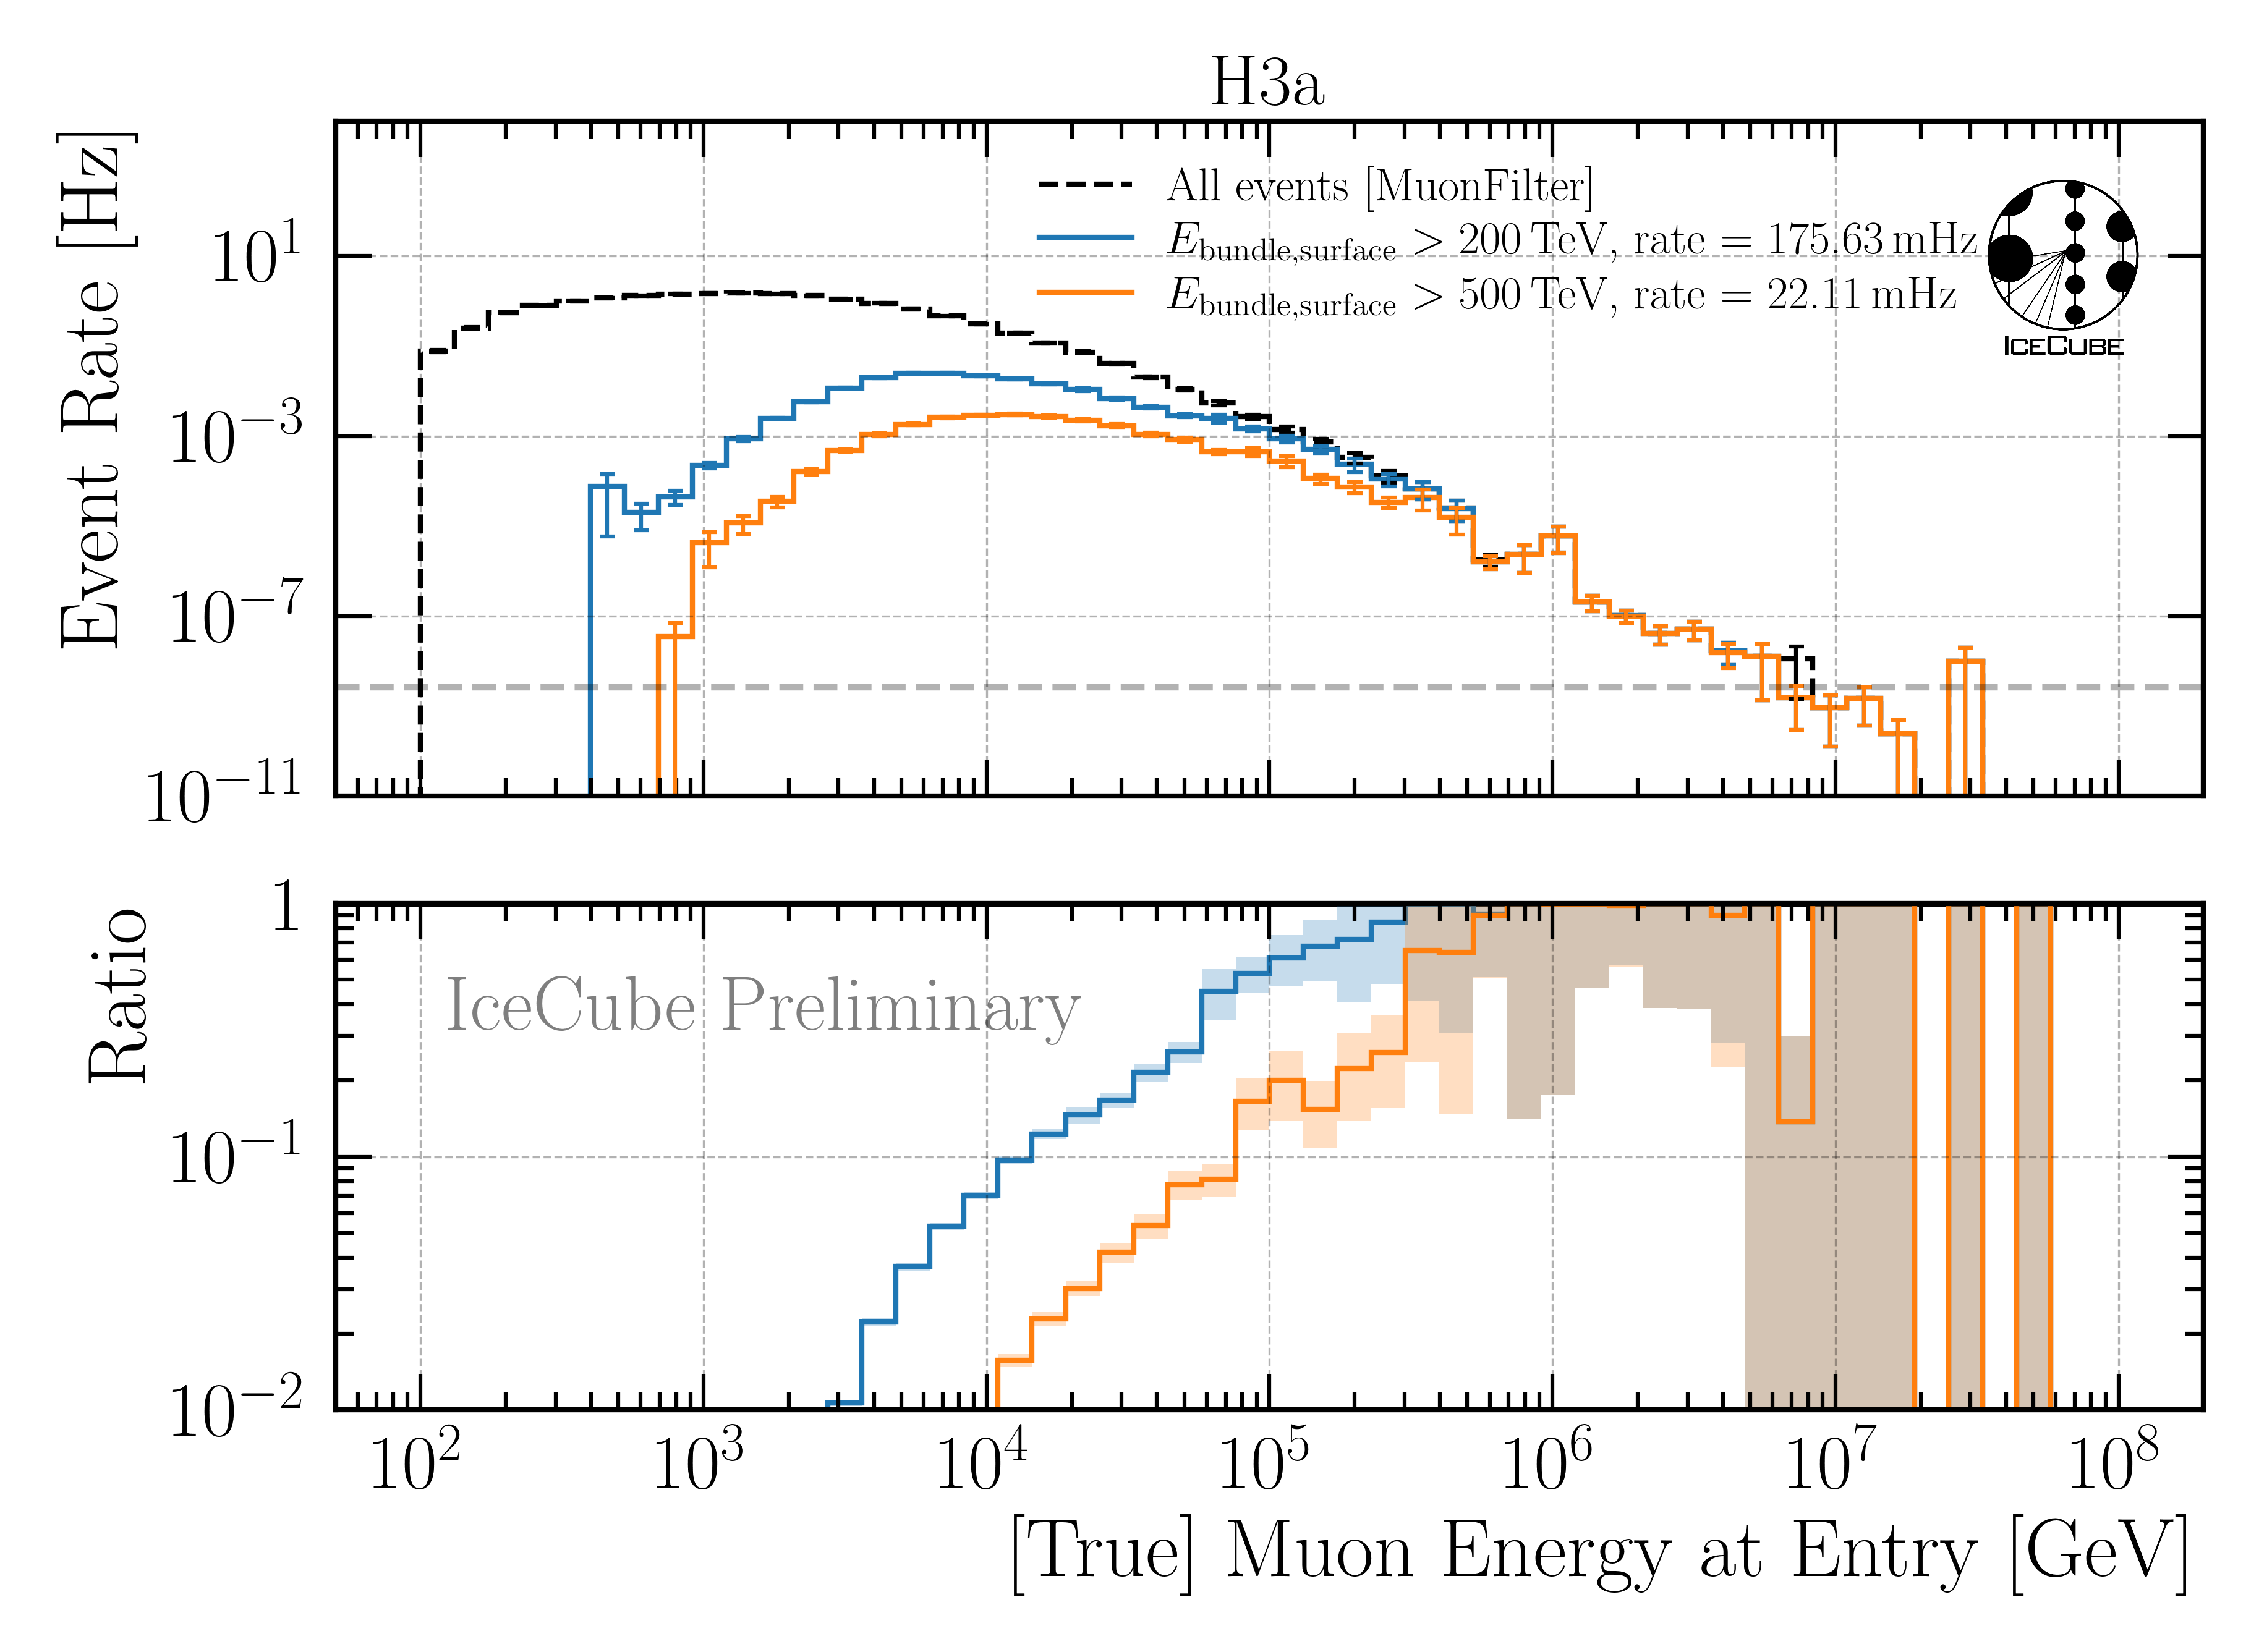
Level 4: Energy Cut
6 billion events expected in 10 years → computationally not feasible
focus on high-energetic events
Remove low-energy muons: bundle energy at surface > 500 TeV

Slide 36






Level 5: Data/MC Quality Cuts
Remove outliers
Depth—dependent slope (no analysis relevance)
CR—model impact on energy reconstruction
23 quality cuts in total

Slide 37



Final Level: Leadingness > 40 %
L = $\frac{Leading Energy at Entry}{Bundle Energy at Entry}$
No leadingness cut
Leadingness > 40 %
Improve Data/MC by leadingness cut

Slide 38
Unfolding

Slide 39









Unfolding in a nutshell
folding
unfolding
detector response
1. Discretized form: $\vec{g}=A\vec{f}↔\vec{f}=A^{−1}\vec{g}$
measured proxy
background
$$g\left(y\right)= \int_{E0}^{E1}{A\left(Eµ , y\right)f\left(Eµ\right) dEµ+b\left(y\right) }$$
2. Maximum likelihod method:
$$ℒ\left(\vec{g} | \vec{f}\right)=\prod_{j=1}^{M}{\frac{λ_{j}^{g_{j}}}{g_{j}!}exp⁡(−λ_{j})}$$
3. Thikonov regularization:
$$t\left(\vec{f}\right)=−\frac{1}{2}{\left(C\vec{f}\right)}^{T}{\left(τ1\right)}^{−1}(C\vec{f})$$
true energy distribution
$$=\prod_{j=1}^{M}{\frac{{(A\vec{f})}_{j}^{g_{j}}}{g_{j}!}exp⁡(−{(A\vec{f})}_{j})}$$
funfolding
by M. Börner
4. Maximize $log⁡(ℒ\left(\vec{g} | \vec{f}\right))+t\left(\vec{f}\right)$
with respect to $\vec{f}$ using
Markov Chain Monte Carlo (MCMC)
or Minuit
Credit: T. Hoinka

Slide 40
Muon Flux Unfolding
Effective area
Systematics
Proxy that correlates with target
Regularization
Unfolding

Slide 41








Ice & Detector Systematics
σ_{sys,i} = max($A_{low}, A_{high}) −Abase$
$$σ_{tot}=\sqrt{σ_{stat}^{2}+\sum{σ_{i}^{2}}}, i:scat, abs, DOME, holeice p0, p1$$
Baseline: entire set
Subset: above/below center

Slide 42

Reconstruction and Data—MC: Leading Muons
Good reconstruction of leading muon energy → proxy
Good data—MC agreement
Global offset → upscale MC by 12%

Slide 43


Correlation and Robustness Test: Leading Muons
Build unfolding matrix on H3a, H4a, GST & GSF
Unfold H3a as test set
Results are within uncertainties → robust
Correlation between proxy and target
Burnsample

Slide 44


Determine Regularization
Find regularization 𝜏 with minimal bin-to-bin correlation
LLH minimization (unfolding) provides full covariance matrix V
Minimize global correlation
$$ρ=\sum{V_{ij}}$$
$$i>j$$
Unfold MC truth → ratio should be 1
Burnsample

Slide 45

Burnsample Unfolding
Leading muons
2487 h IceCube data
12754 events
Agrees with MCEq

Slide 46


Prediction: 12 Years of IceCube Data Unfolding
Pseudo Sample has prompt
Pseudo Sample has NO prompt
MC only
MC only
Ratio to conv
Ratio to conv
Ratio to total
Unfolding is sensitive to the prompt component
*with systematic uncertainties from effective area

Slide 47




Event Rate to Flux → Effective Area
Unfolding estimates an event rate
Transfer event rate to flux
with solid angle
and effective area

Slide 48

Determine Regularization
Find regularization 𝜏 with minimal bin-to-bin correlation
LLH minimization (unfolding) provides full covariance matrix V
Minimize global correlation
$$ρ=\sum{V_{ij}}$$
$$i>j$$
Unfold MC truth → ratio should be 1
Burnsample

Slide 49

Muon Flux Unfolding
Leading muons
2487 h IceCube data
12754 events
Agrees with MCEq
Stopping muons
47 min IceCube data
32943 events
Below MCEq prediction
*Stopping muon analysis done by Lucas Witthaus

Slide 50


Level 5: Data/MC Quality Cuts
Neutrino weighting:
SPL: n = 1.8, 𝛾 = 2.52
IceCube Collaboration PoS ICRC2023 1064
Good directional reconstruction
Cut: cos(zenith) > 0.2

Slide 51
Level 5: Data/MC Quality Cuts
Remove outliers
Depth—dependent slope (no analysis relevance)
CR—model impact on energy reconstruction
23 quality cuts in total

Slide 52


Bundle Energy Reconstruction
Level 4
Level 5
IceCube Preliminary
IceCube Preliminary

Slide 53


Muon Filter

Slide 54


Correlation and Robustness Test: Stopping Muons
Build unfolding matrix on H3a, H4a, GST & GSF
Unfold H3a as test set
Results are within uncertainties → robust
Correlation between proxy and target

Slide 55

Cosmic ray flux
Arxiv: 1903.07713
Notes:
1. Knee: ~3 PeV, before gamma = 2.7, limit of acceleration mechanism for cosmic rays in supernova remnants 2. Knee: ~100 PeV, before gamma = 3.1, heavier elements, like iron, from galactic sources start to reach their maximum acceleration energy → more protons, larger energy in electromagnetic acceleration Ankle: ~1 EeV, flattens out again, transition point between galactic and extra galactic particle origin,

Slide 56




Air shower – 10 TeV
Ralph Engel 2005
“muon bundles”
2211.16970v2
Proton
www.iap.kit.edu/corsika
Iron
Notes:
shower maximum: x_max, slant depth at which the number of particles is the greatest, more energetic and lighter cosmic rays produce deeper/lower x_max, while heavier nuclei have a higher shower maximum
measure number of particles / muons
lateral spread
nitrogen can be excited → fluorescence light emitted
iron produces more muons than proton, because it has 56 nucleons → higher fragmentation → “sub-showers”

Slide 57

Prompt atmospheric muons and neutrinos
10.1103/PhysRevD.100.103018
no unflavored
dominated by pions
dominated by kaons
Combined fit:
handle on pion/kaon ratio
handle on charmed mesons

Slide 58




Muon puzzle and model uncertainties
”muon number”
Expected z
(“muon number”)
2012
2108.08341
1208.1520
Uncertainties at E > 10 PeV
2020
More muons measured than simulated for E > 40 PeV ~ cms 8 TeV
2006.05012

Slide 59
CORSIKA 7 tagging and MCEq comparison
MCEq: tool to numerically solve the cascade equations that describes the evolution of particle densities as they propagate through a gaseous, dense medium
https://github.com/mceq-project/MCEq
GSF weighting
GSF weighting
Good agreement in total prompt and conv muon flux
D⁰ and D_{s} are swapped here but this is fixed in MCEq
mention panama

Slide 60

Machine Learning Reconstructions
10.1088/1748-0221/16/07/P07041
Credit: IceCube
Convolutional Neural Network
Inputs
c_{total}: Total charge
Sum of charge
t_{first}: Relative time of first pulse
Relative to total time offset
t_{std}: Standard deviation of first pulse
Charge weighted standard deviation of pulse times
Outputs
Direction
Stopping point
Entry point
Energy at entry/surface
…
Credit: IceCube

Slide 61
Level5: quality cuts
containment cuts | > | <
length in detector | 1000 m | 2000 m
entry pos x, y | -750 m | 750 m
entry pos z | -500 m | 750 m
center pos x, y | -550 m | 550 m
center pos z | -650 m | 650 m
uncertainty cuts | <
bundle energy at entry | 0.9 log10(GeV)
bundle energy at surface | 2.0 log10(GeV)
zenith | 0.1 rad
azimuth | 0.2 rad
entry pos x , y, z | 42 m
center pos x, y, z | 50 m
entry pos time | 200 ns
center pos time | 600 ns
length in detector | 160 m
length | 2000 m
neutrino cuts | > | <
cos(zenith) | 0.2
length | 5000 m | 15000 m

Slide 62

The Muon Puzzle
”muon number”
Arxiv: 2108.08341

Slide 63

Possible Solutions
Slide taken from Hans Dembinski

Slide 64

MCEq vs CORSIKA

Slide 65
Overview
Simulation
Reconstruction
Selection
Unfolding
Dataset
CORSIKA 77500 Ehist
SIBYLL 2.3d
10 TeV – 100 EeV
DNN reconstructions
Muon energies
Muon direction
Track geometry
Level 3
L2 muon filter
Add labels
Muon spectrum
Unfold muon flux at surface
Level 4
500 TeV bundle energy cut at surface
Add DNN reconstructions
Validation
Tag prompt / conv particles
MCEq comparisons
Level 5
Data-MC quality cuts
Final Level
Leadingness cut

